Slide 1
Nanoimprint Lithography
LAB COURSE PRESENTATION
PRESENTED BY: PRESENTED TO:
AVISHEK SARBAJNA (2325748) QIAOSHUANG ZHANG
HEND KHOLEIF (2328656)

Slide 2
Outline
Theory of Nanoimprint Lithography (NIL)
Comparison of NIL with optical UV Lithography
Experiment Steps
Theory of Scanning Electron Microscope (SEM)
SEM Imaging of Samples
Conclusion

Slide 3
Theory of NIL

Slide 4
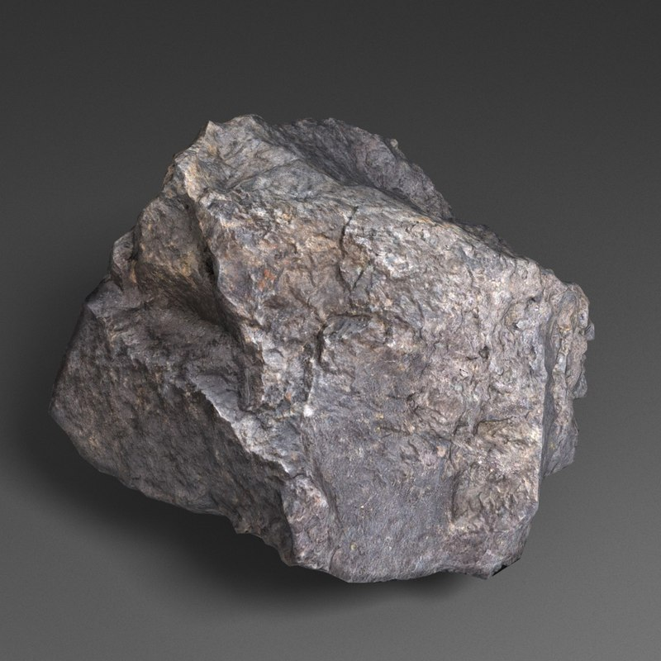
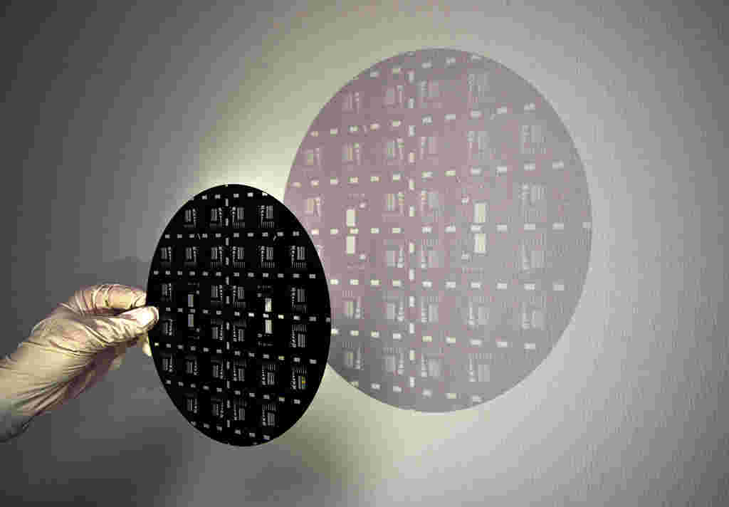
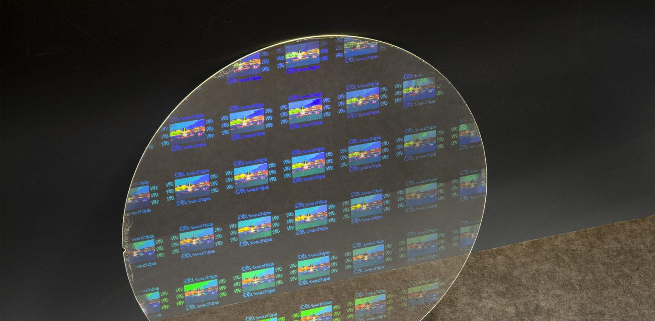
What is Lithography
Lithography = (Lithos + Graphia)
Stone
Write
A method of producing three-dimensional relief patterns on a substrate.
Nanolithography is one of the main processes in IC semiconductor industry and the main driver in maintaining Moore’s law.

Slide 5
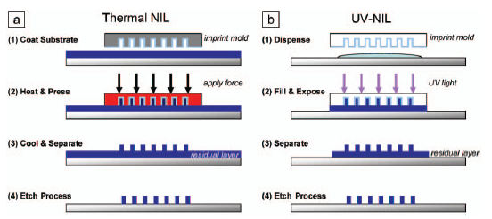
Nano Imprint Lithography
1- A structured master is replicated by a soft molding material (eg. PDMS).
2- The soft stamp (mold, eg. PDMS) is pressed onto a UV-curable polymer (eg. ORMOSTAMP).
3- The polymer is hardened by UV exposure and then the stamp is removed.

Slide 6
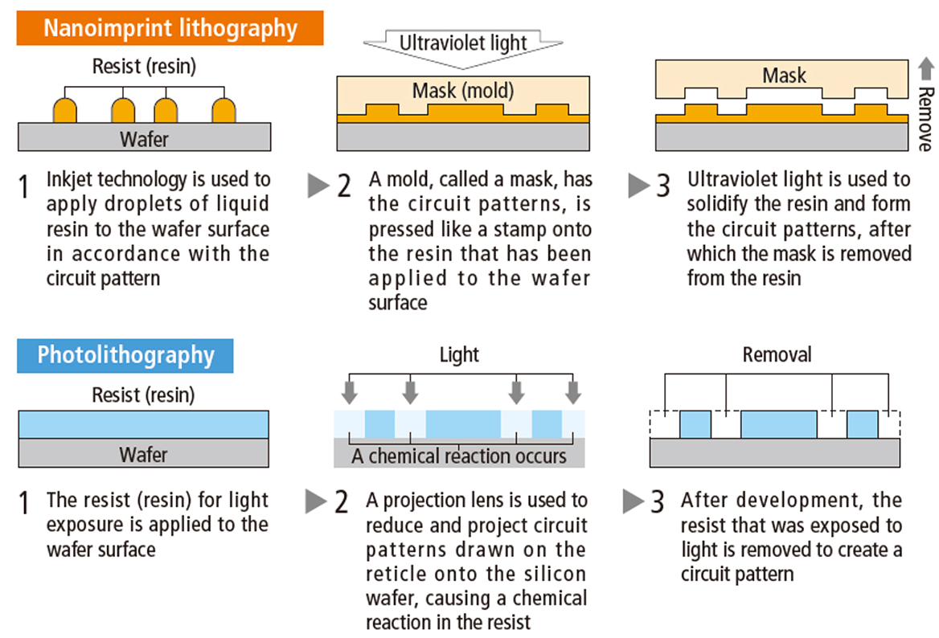
Comparing with Optical Lithography
Unlike optical lithography, it does not require expensive and complex optics and light sources for creating images.
Advantages
1. Achieve resolutions beyond limits set by light diffraction or scattering, without complex double patterning or resolution enhancement techniques.
2. Simpler and cheaper process.
3. Suitable for batch processing.
4. Reduces material waste.

Slide 7
Experimental Work

Slide 8
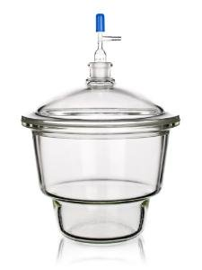
Step 1: PDMS Preparation
PDMS is mixed with its curing agent with ratio of 10:1.
It is important to stir the mixture to reduce bubbles.
It is inserted in a desiccator (30 min.) to remove excess moisture or bubbles.

Slide 9
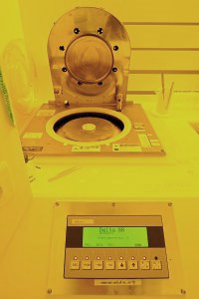
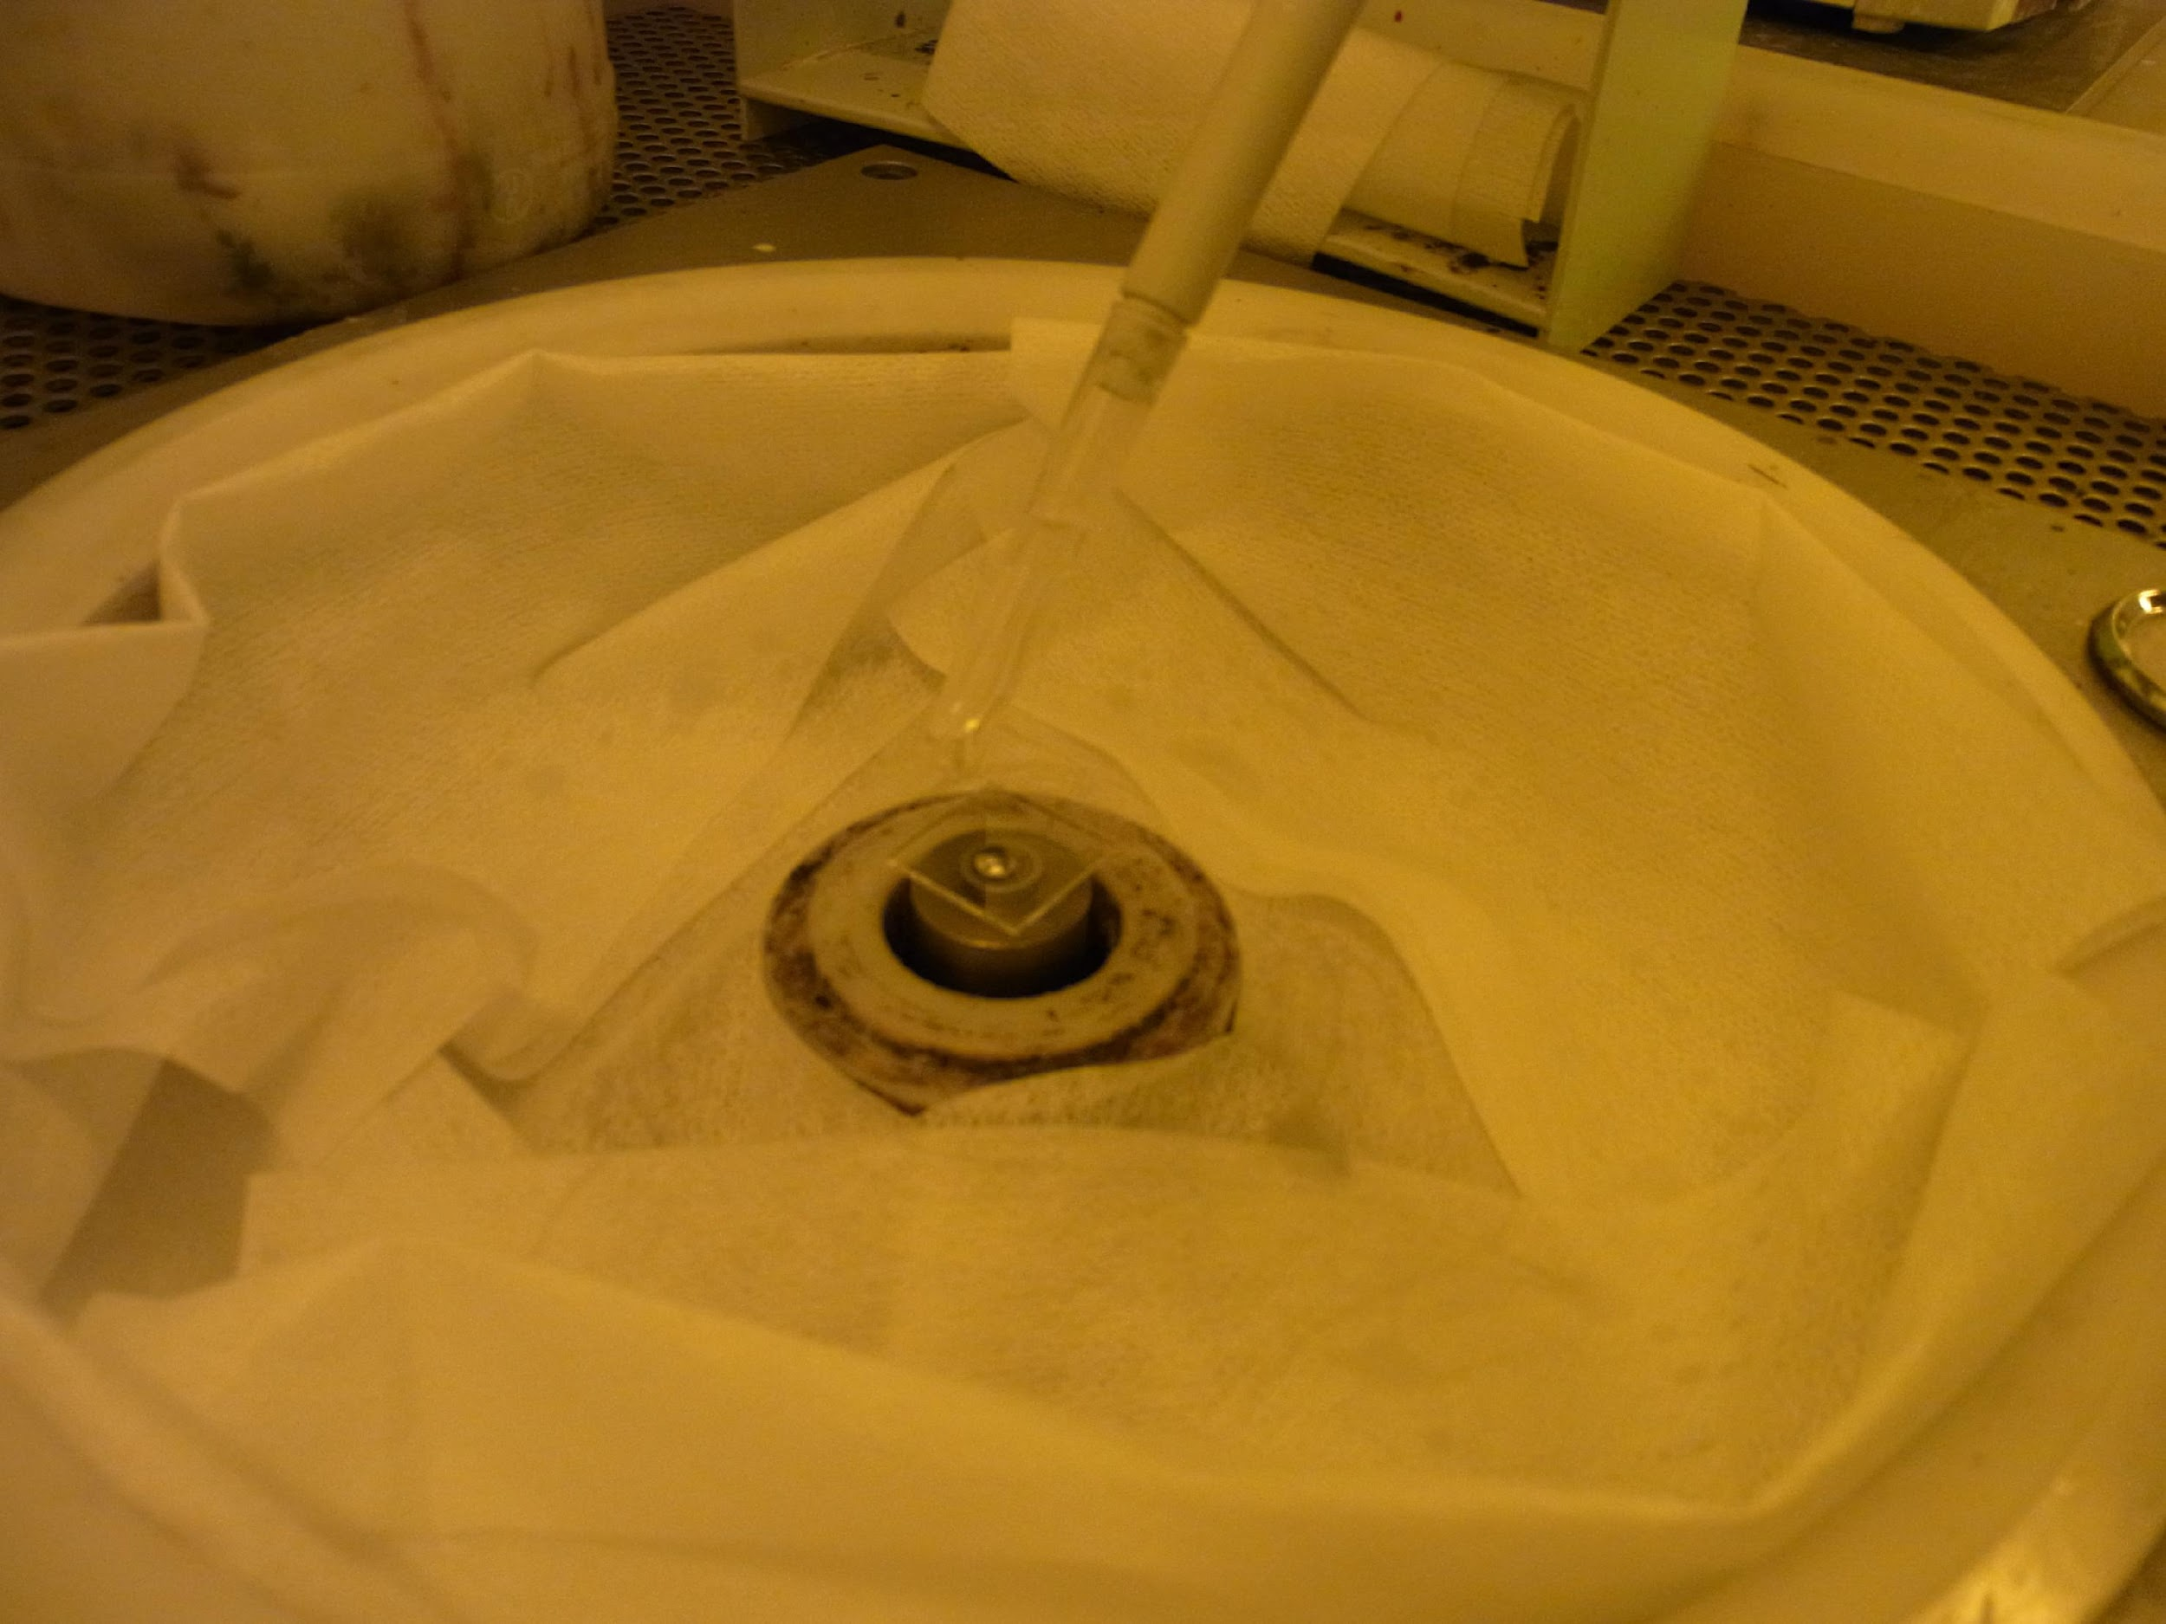
Step 2: Spin-coating of HMDS
Hydrophobic layer of HMDS is deposited by spincoating.
Spin-coating parameters: 800 rpm for 40 seconds.

Slide 10
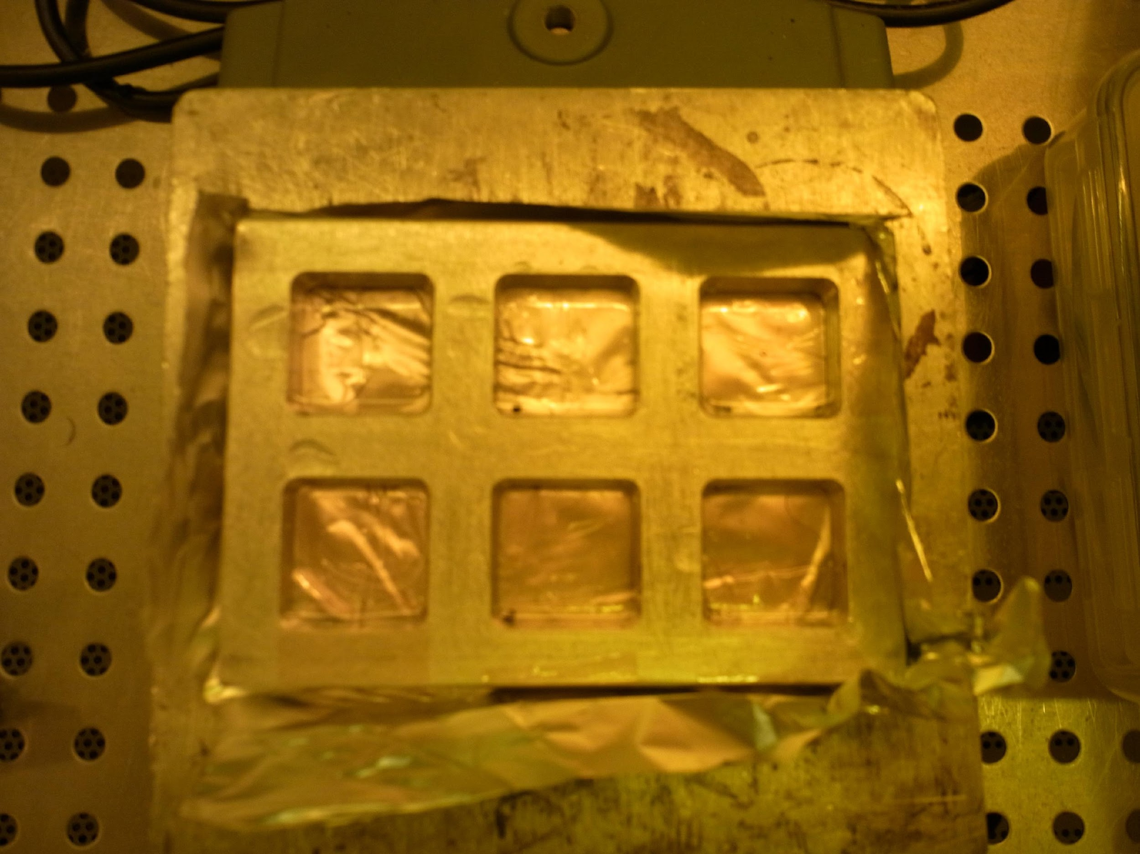
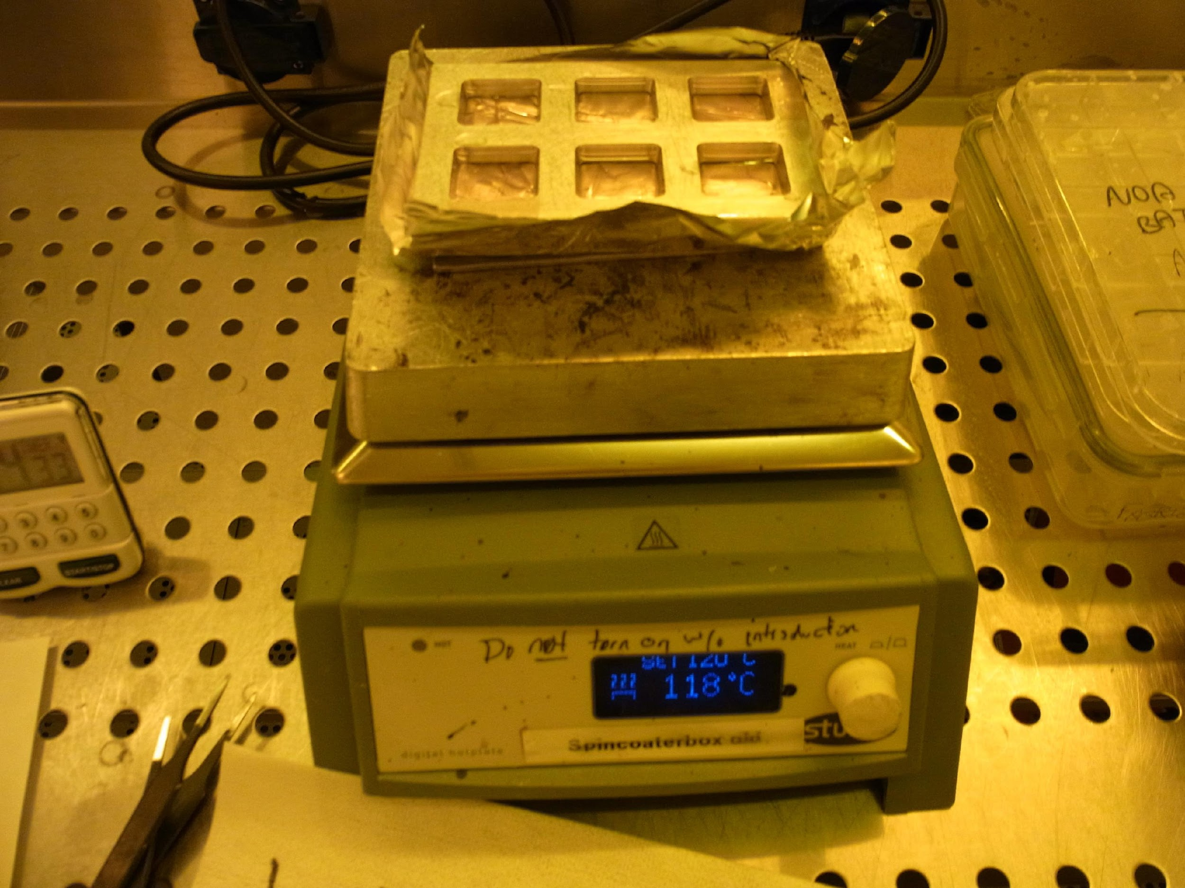
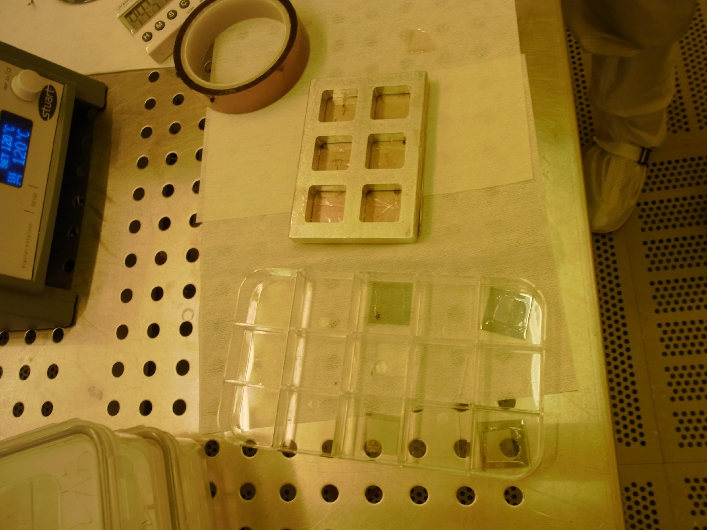
Steps 3 & 4: PDMS deposition on master
PDMS is poured onto the masters to be replicated using an Aluminium mold and thermal resistant tape, so that it can be shaped by the master.
The PDMS + master is cured on a hotplate for 25 min.
After cooling down, PDMS is carefully peeled from the substrates, by removing tape and cutting the hardened PDMS out of the cast.

Slide 11
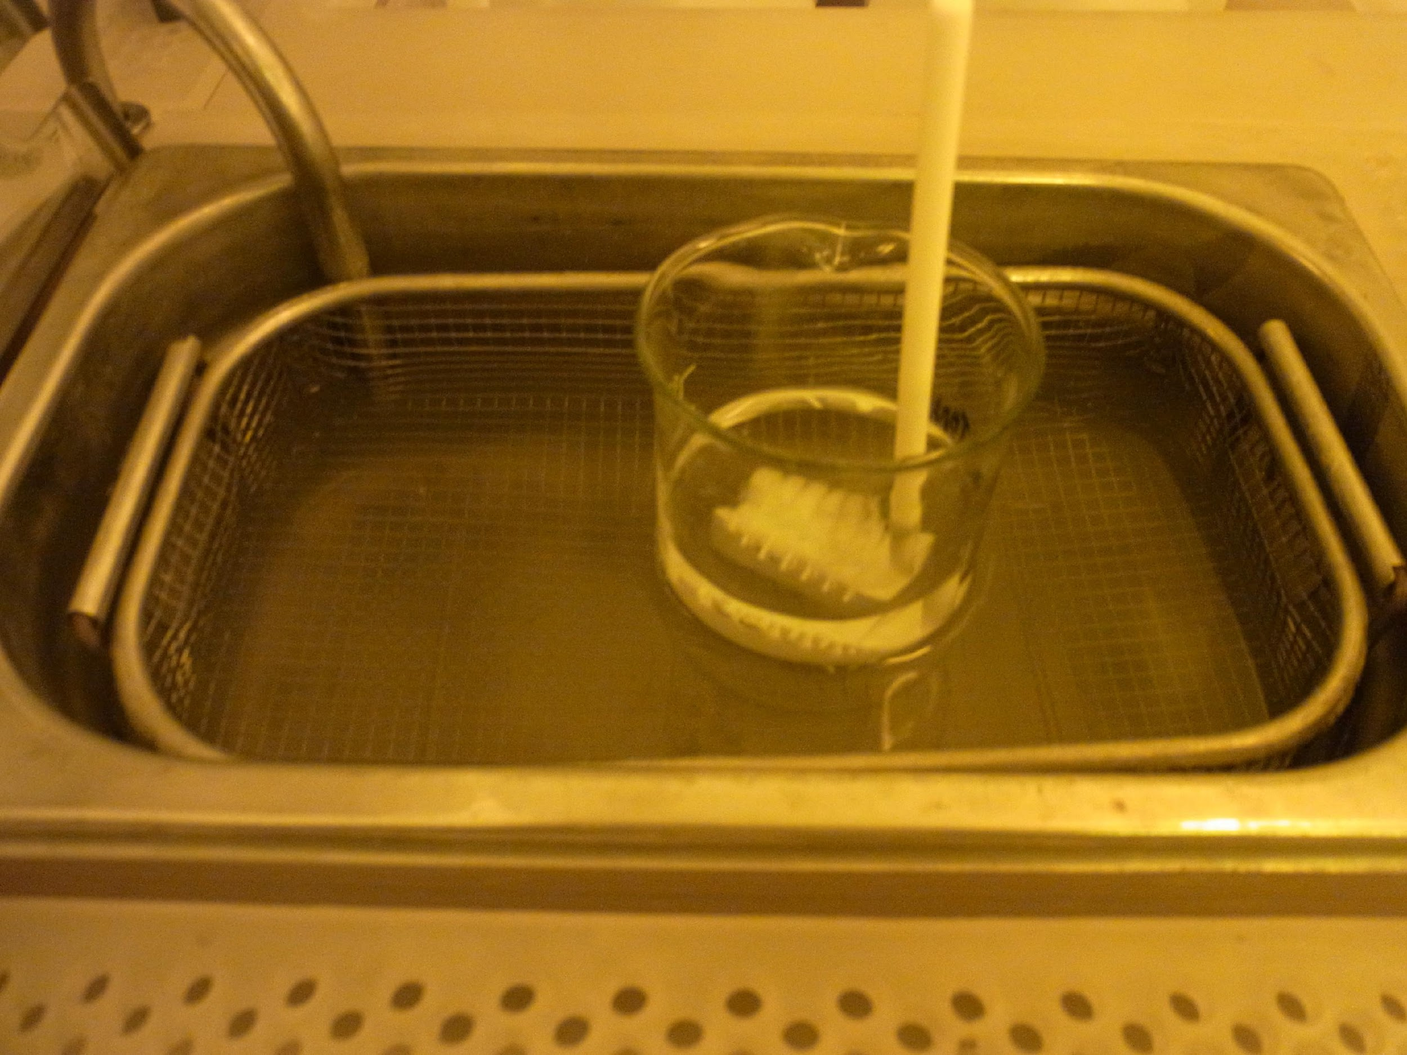
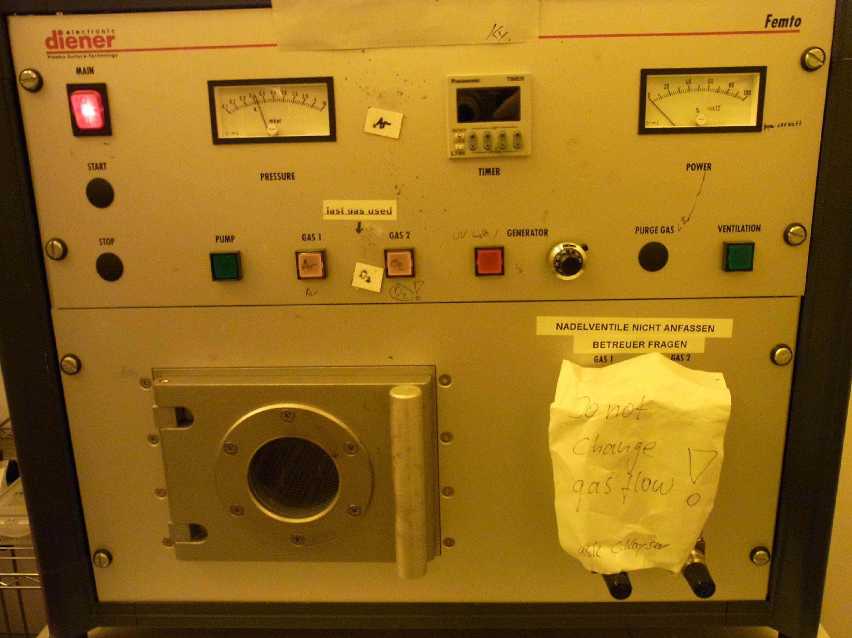
Step 5: Substrate Preparation
Glass substrates are cleaned in acetone and isopropanol each for 5 min.
Then, they are placed in oxygen plasma for 4 min.

Slide 12
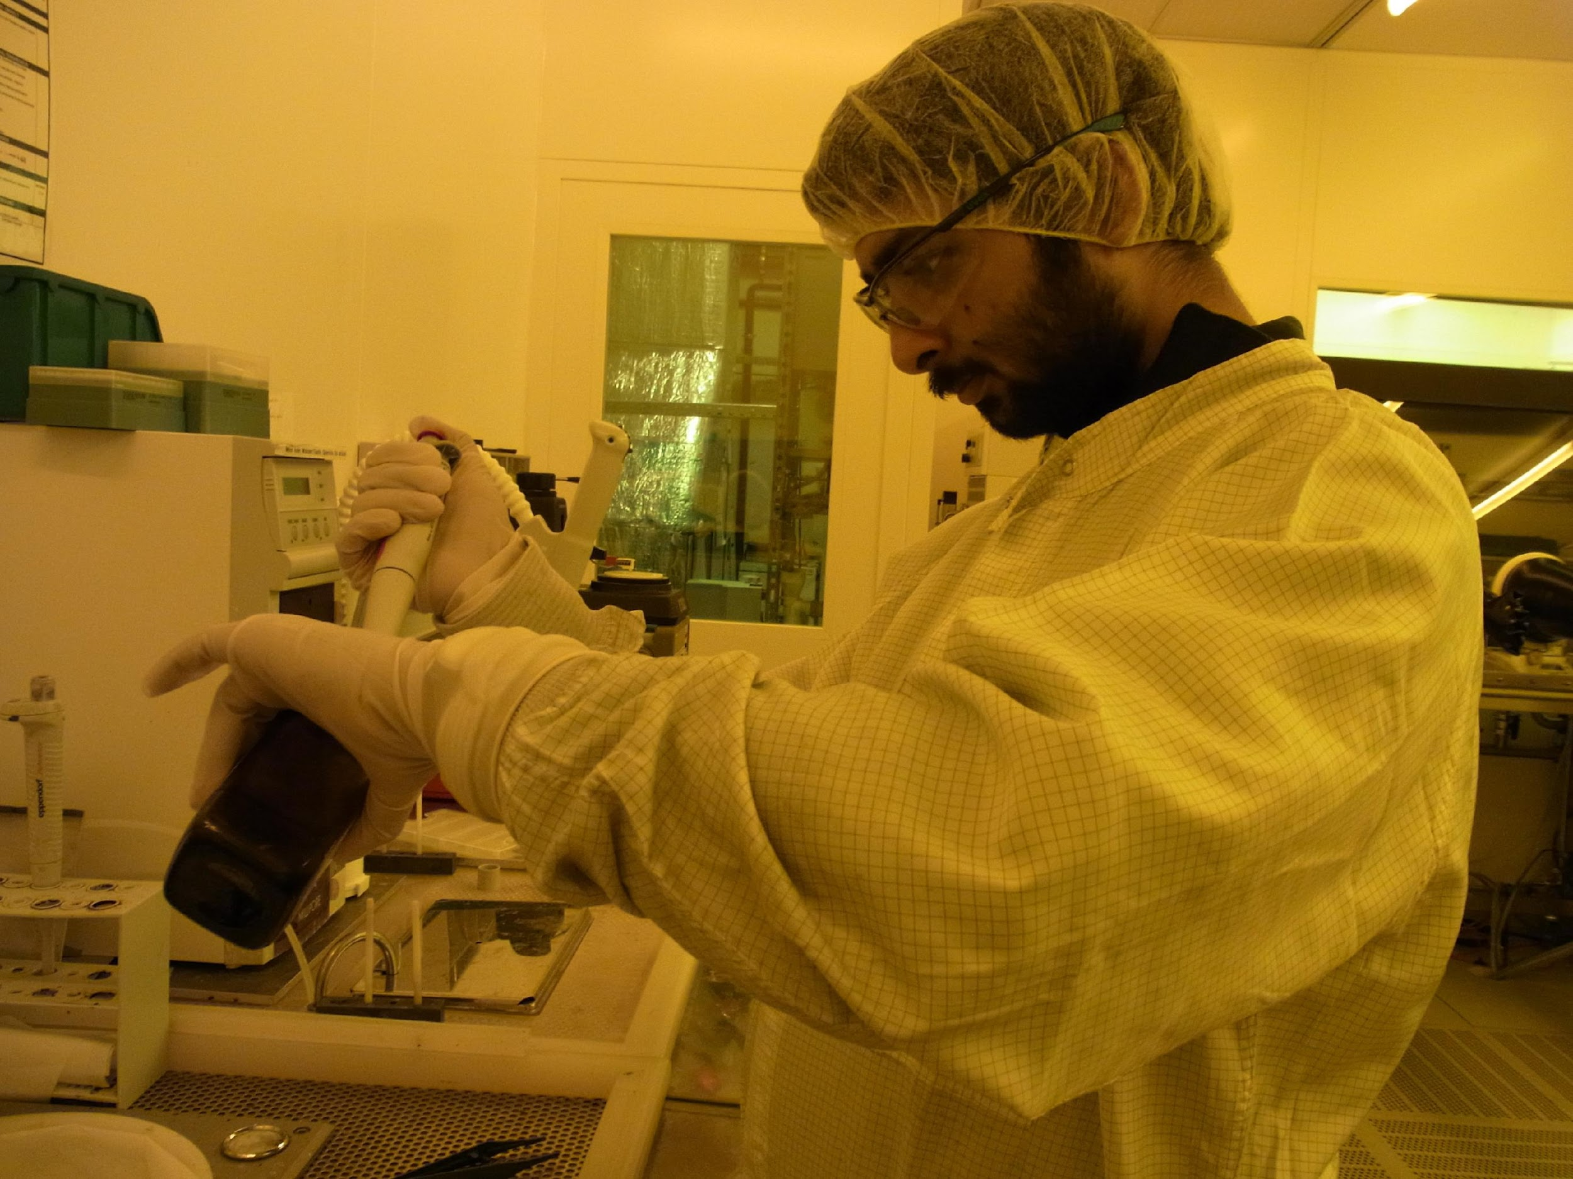
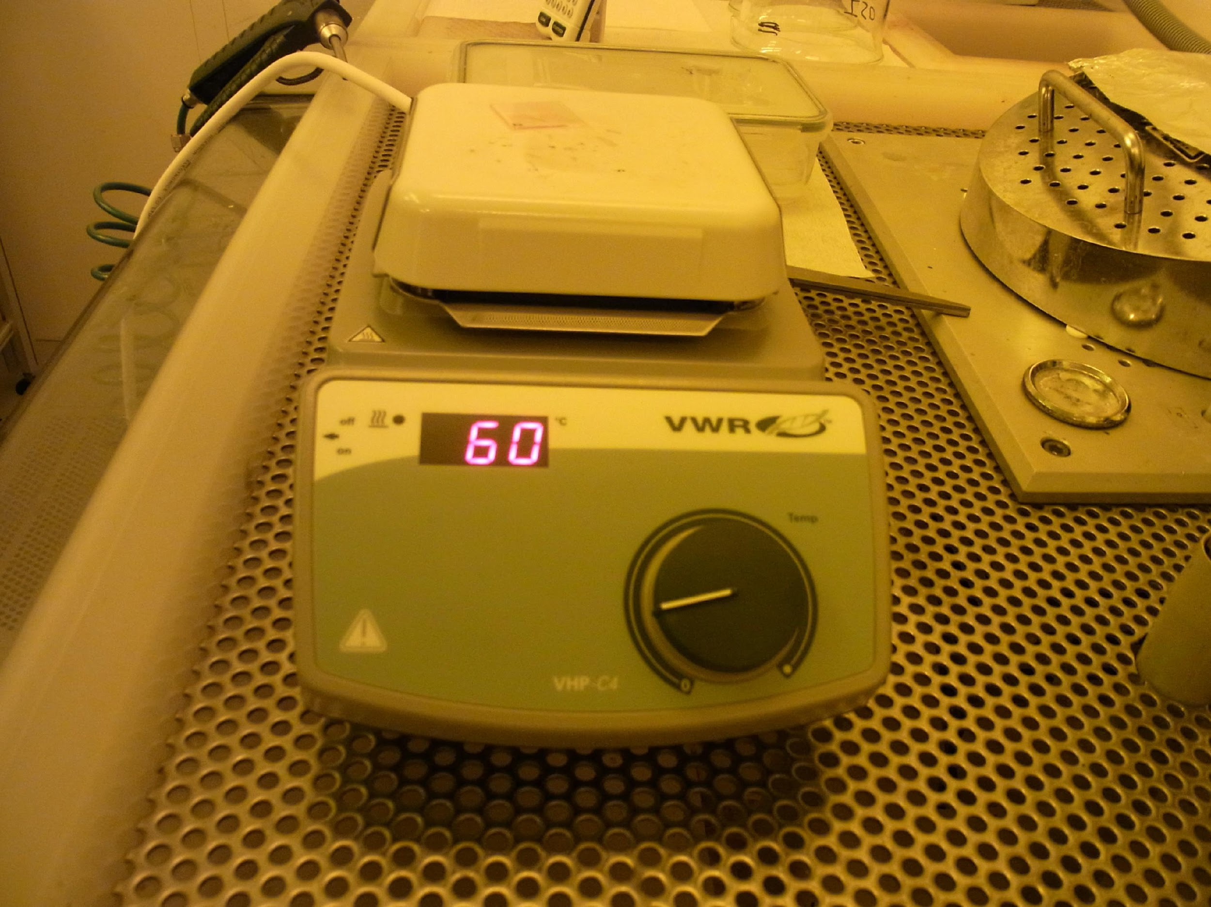
Step 6: Spin-Coating Ormostamp
Ormostamp is inserted into a pipette.
It is spin-coated onto the clean glass slide. (800 rpm for 15 sec, 2500 rpm for 30 sec)
The slide is soft-baked at 80 °C on a hot plate.

Slide 13
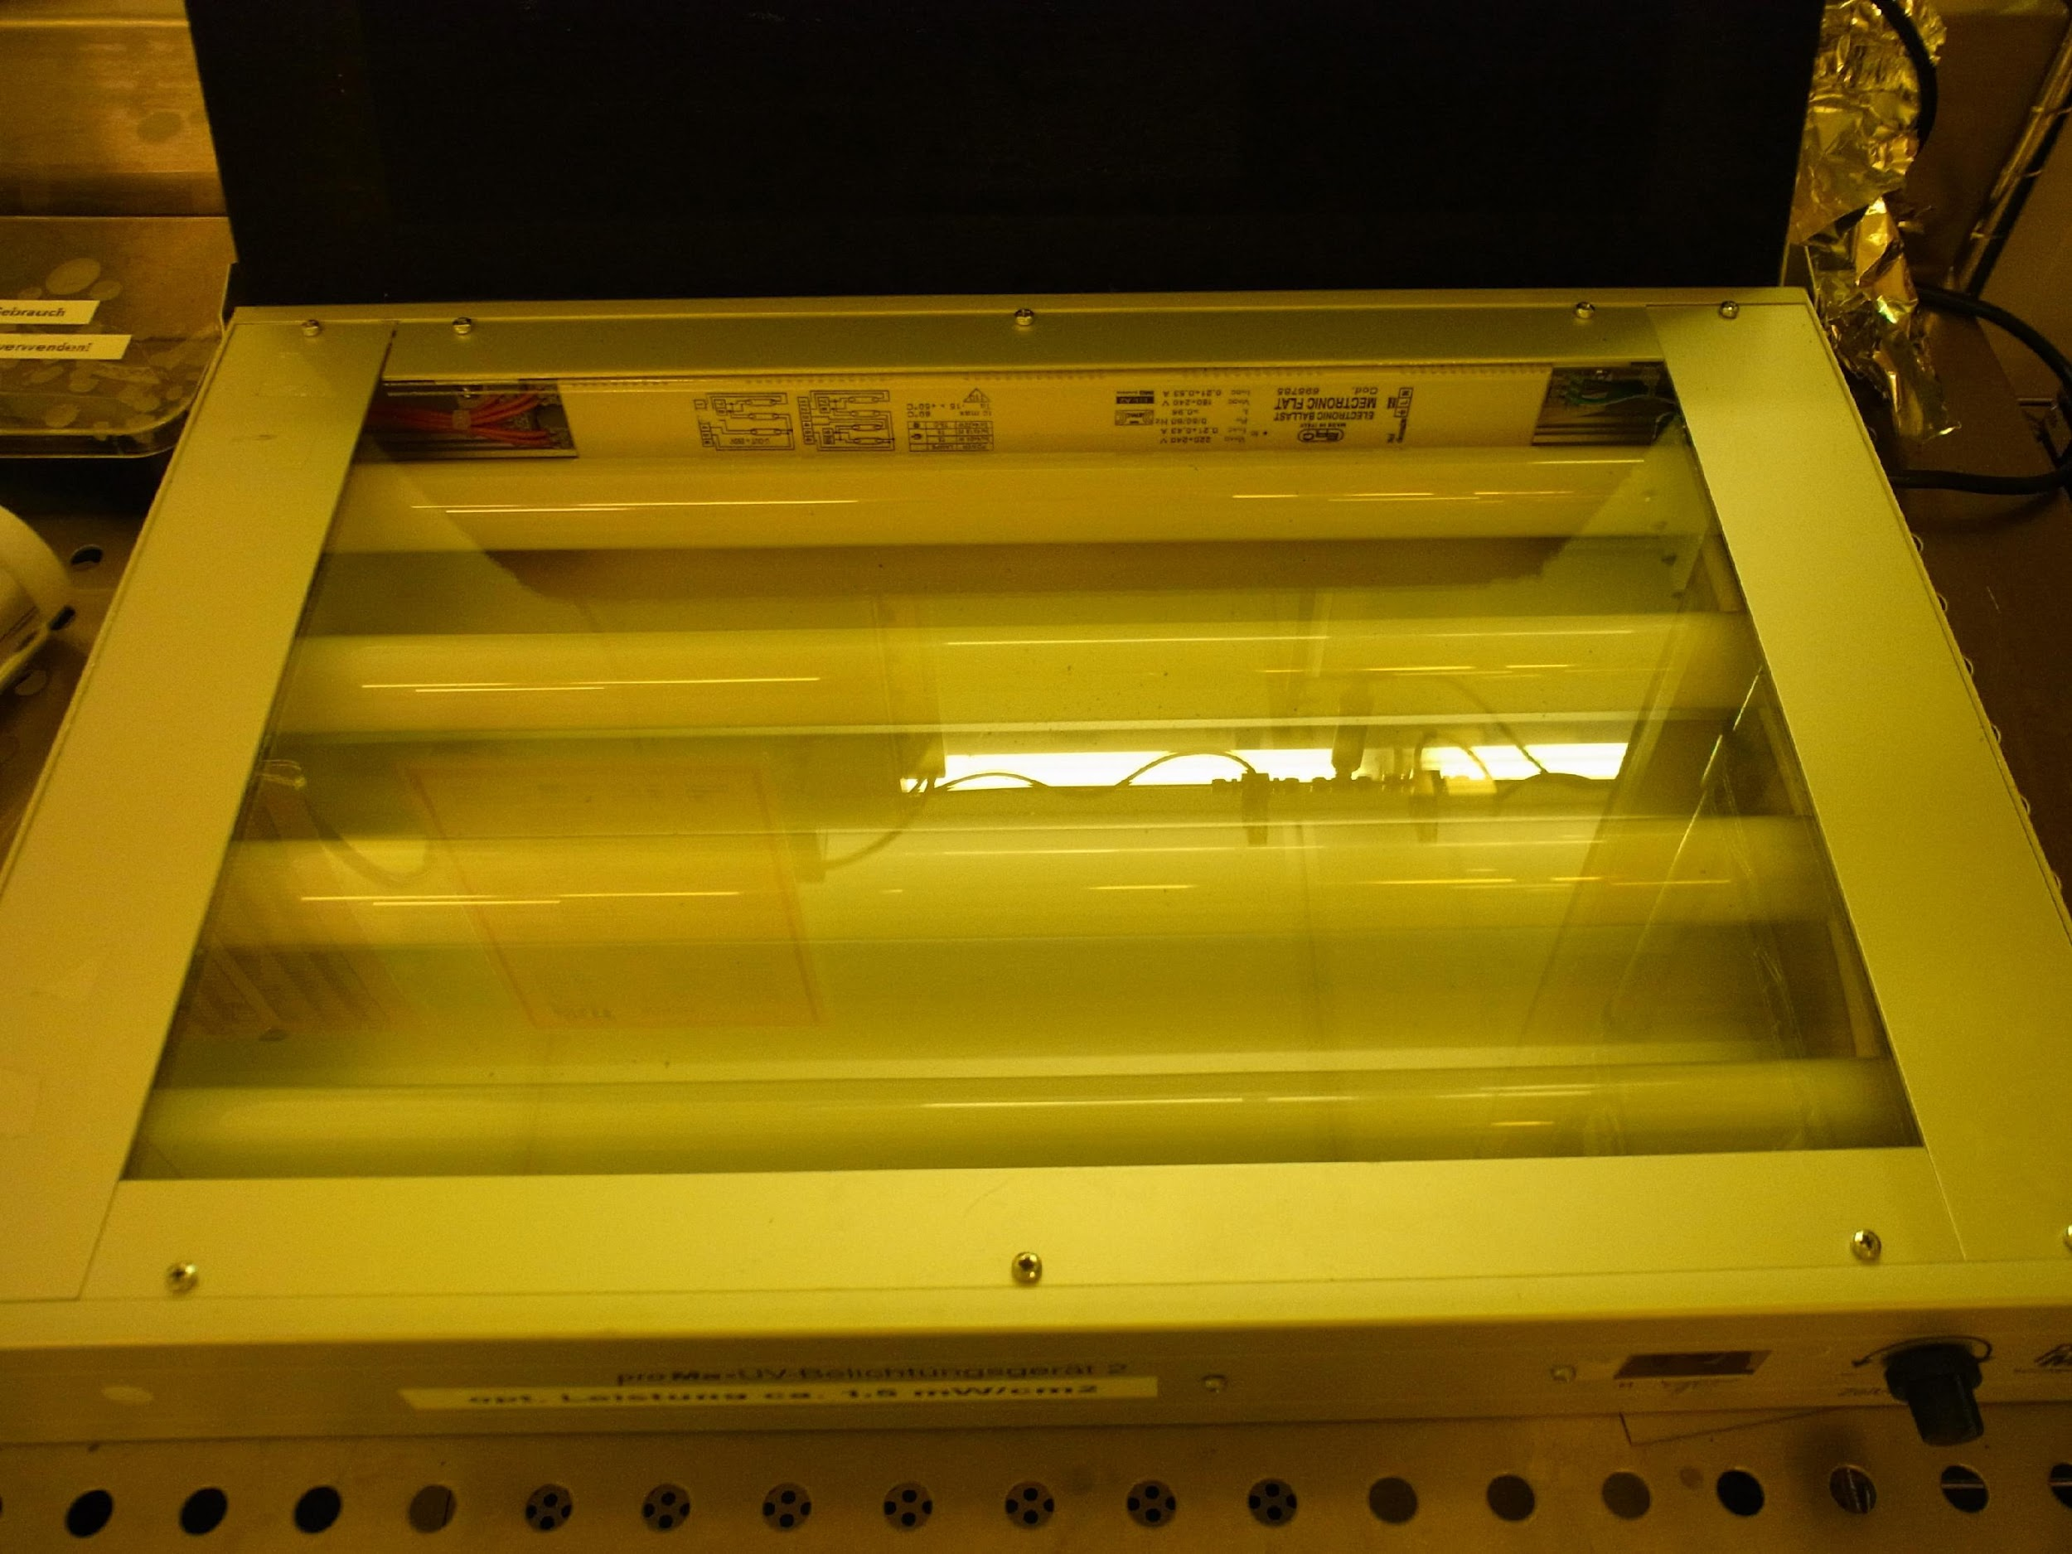
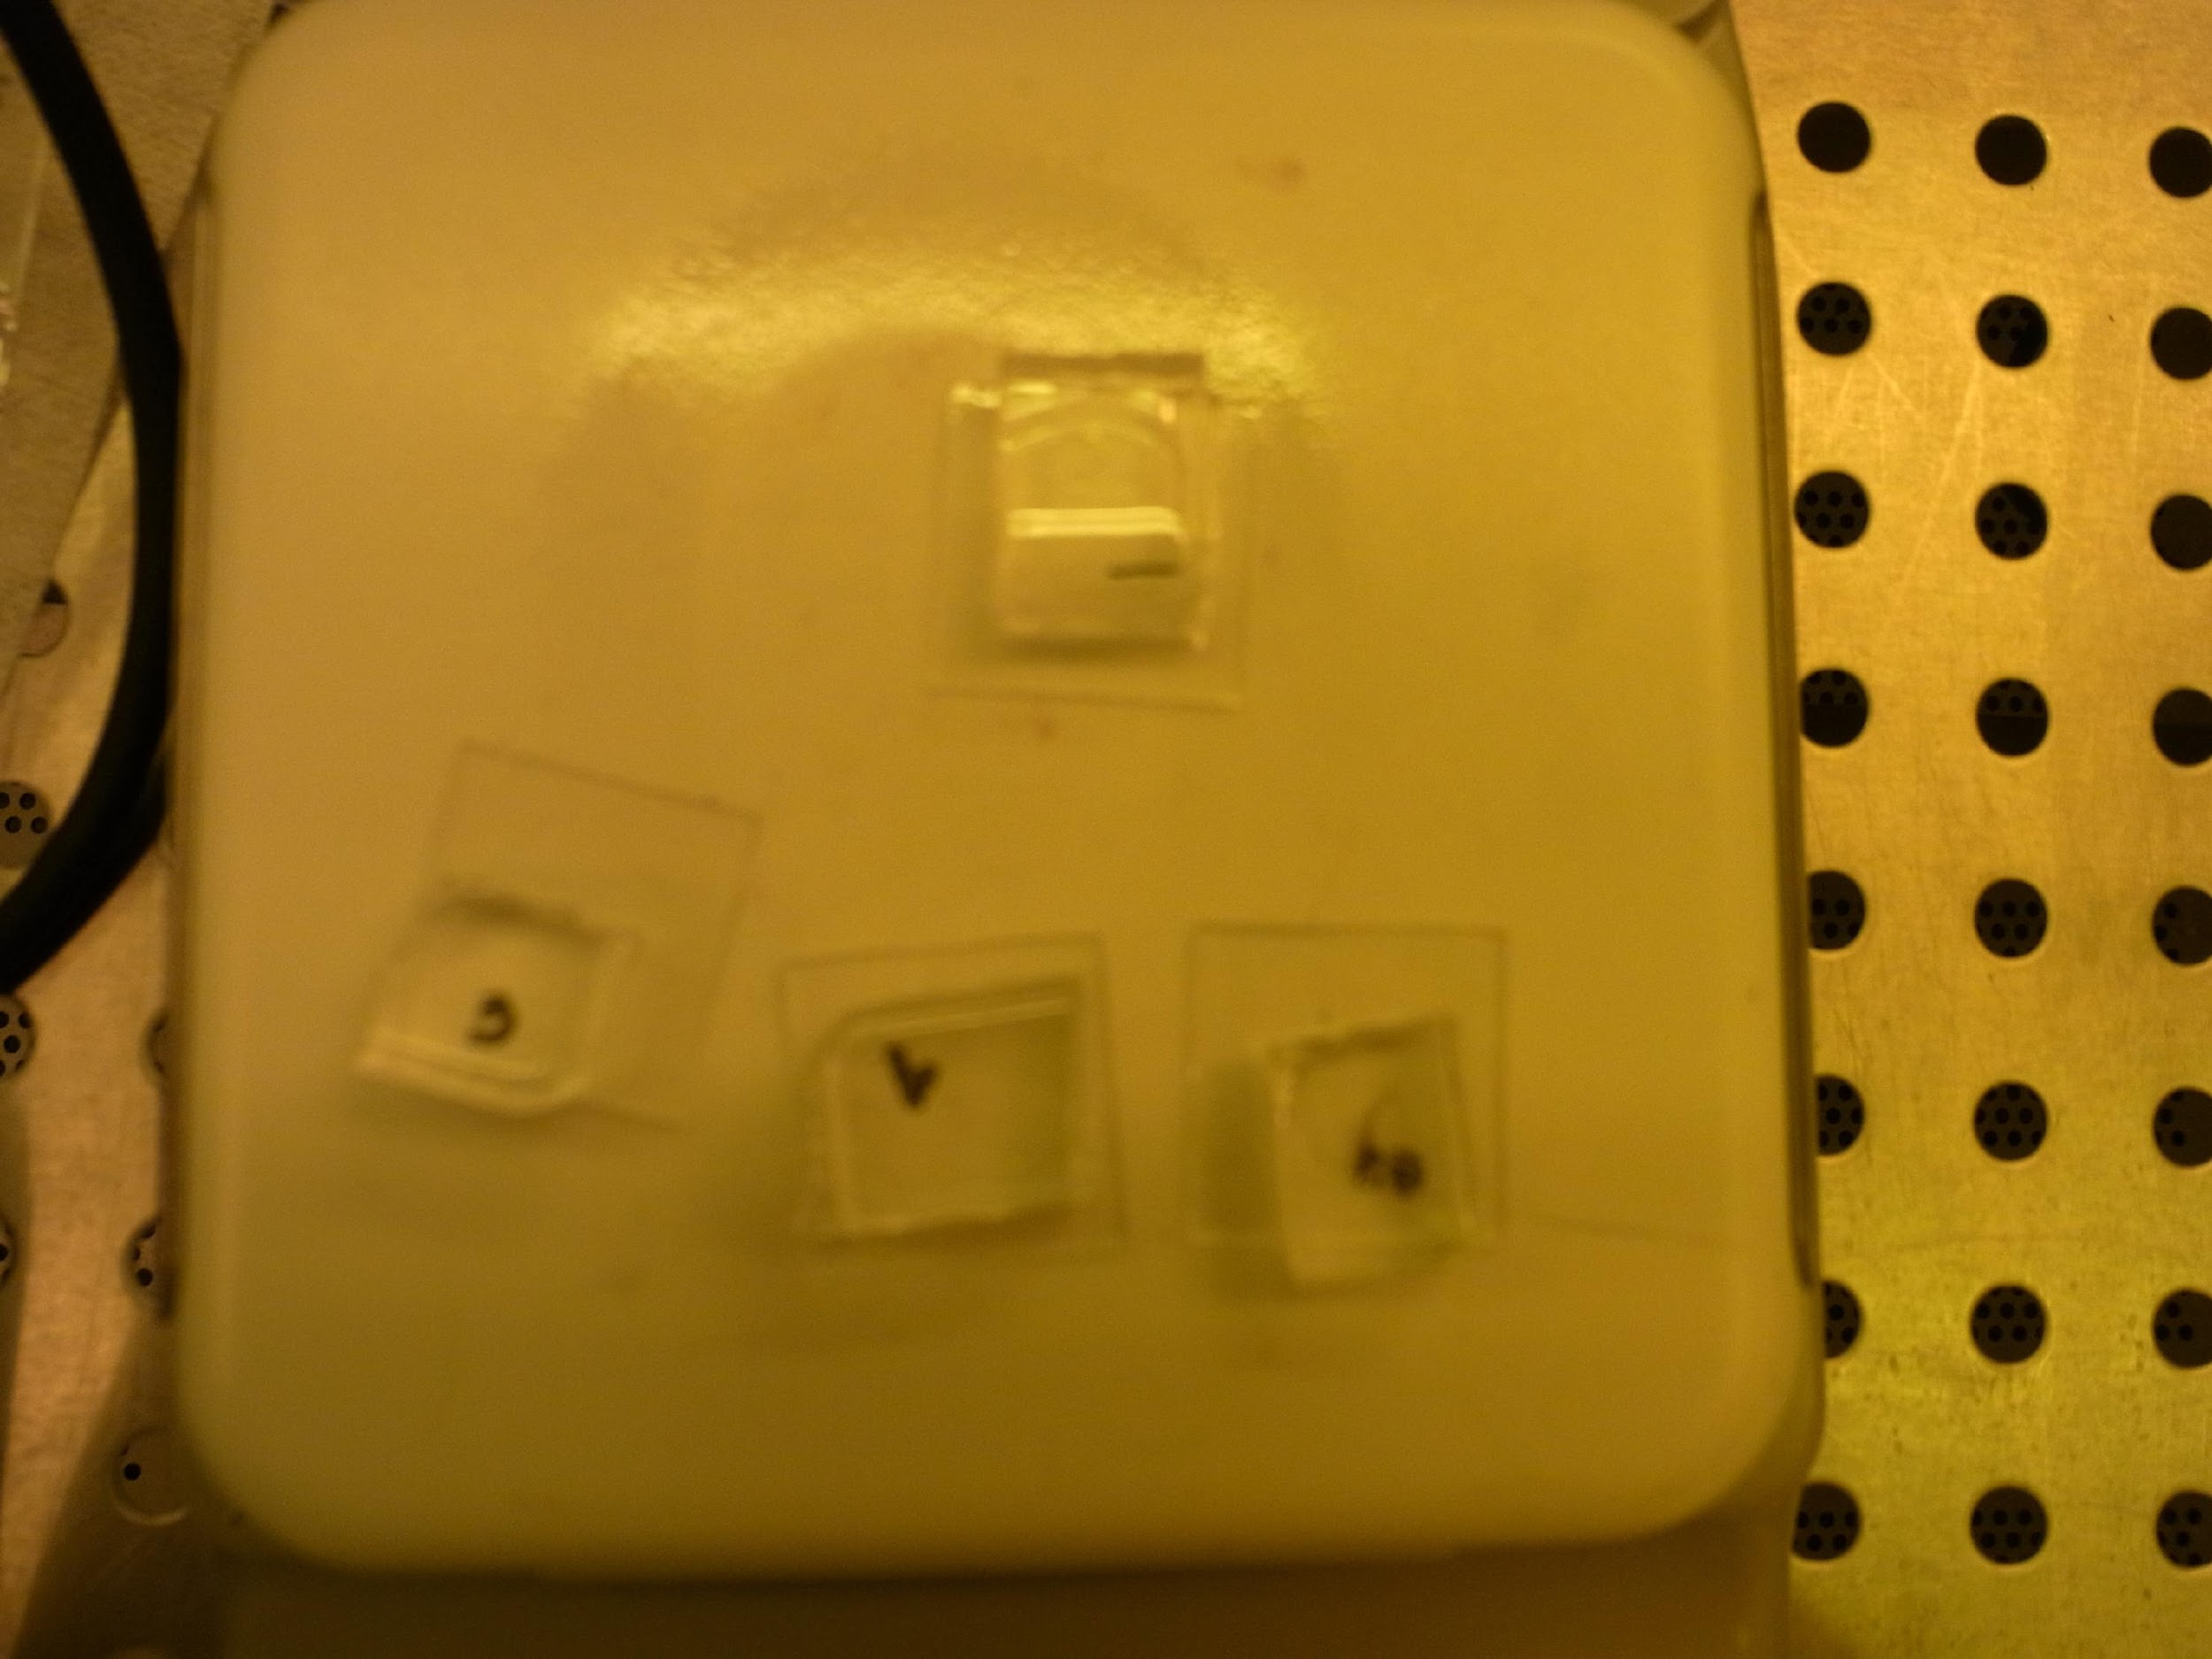
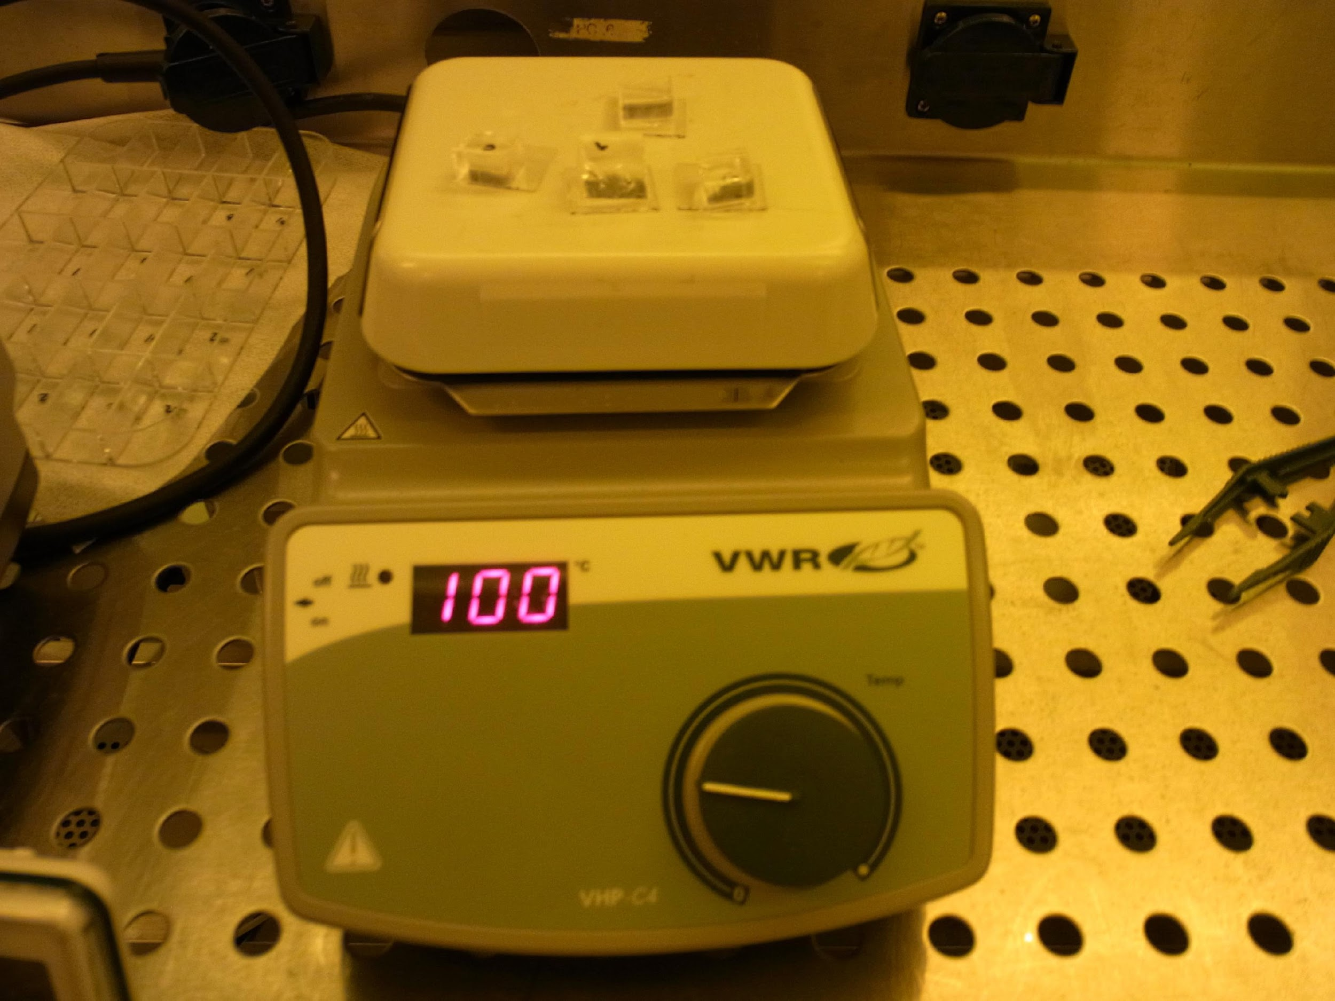
Step 7 & 8 & 9: Placing stamp onto Substrate
PDMS is then carefully placed into Ormostamp, ensuring no air bubbles trapped in between.
The PDMS and substrate together are exposed to UV light for 4 min.
PDMS and substrate are heated (post-exposure bake (PEB)) at 100 °C for 10 min.

Slide 14
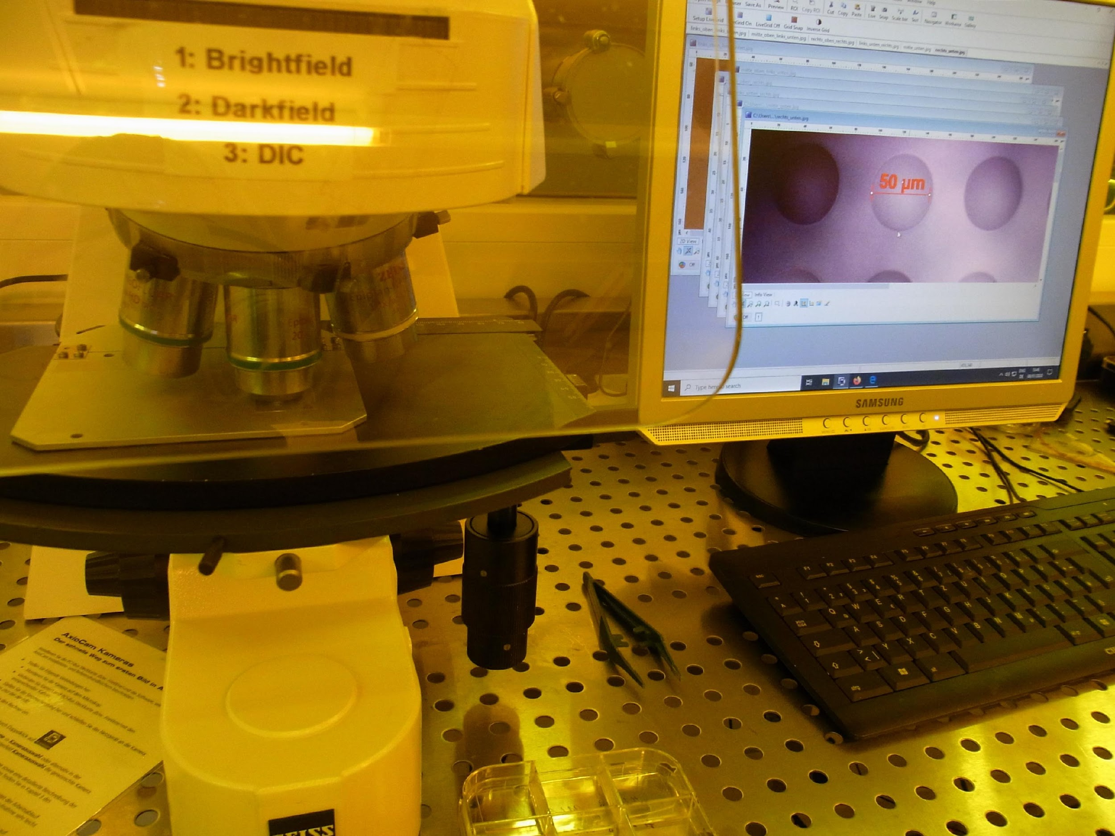
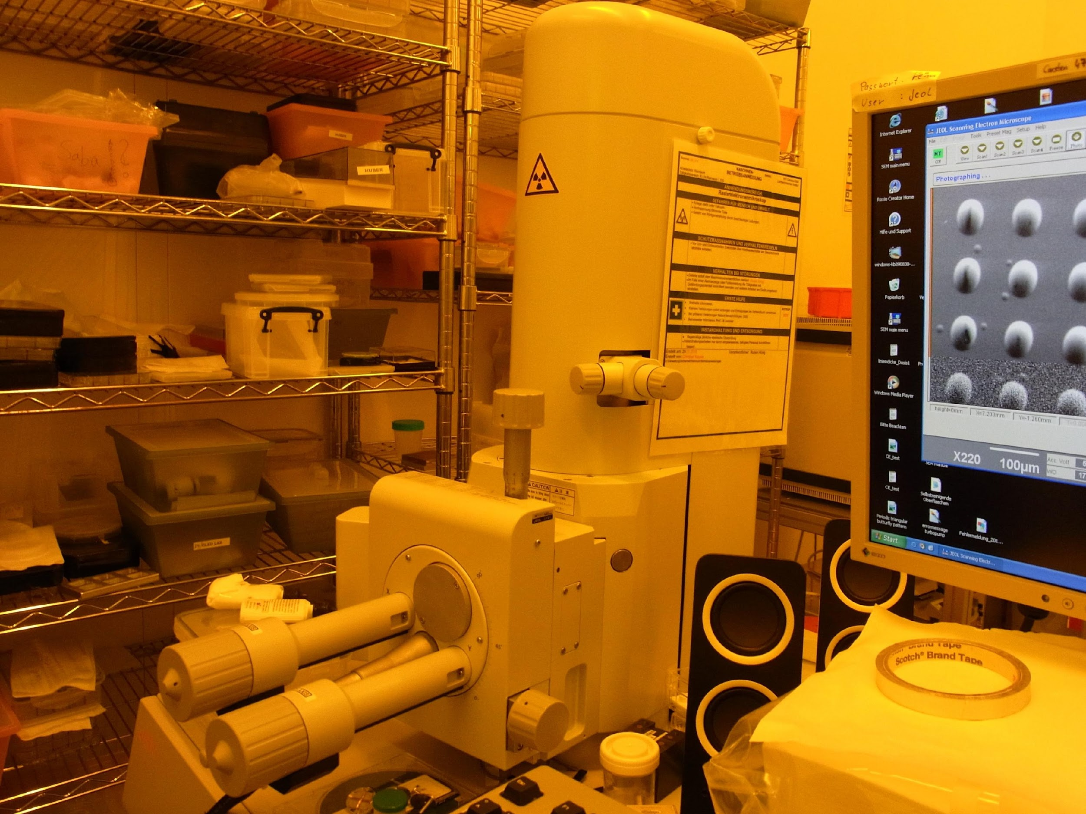
Step 10: Removing PDMS Stamps
Cool back to room temperature, PDMS stamps are carefully peeled from the hardened Ormostamp.
Observe under the SEM microscope and compare with the original stamp.

Slide 15
Theory of SEM

Slide 16
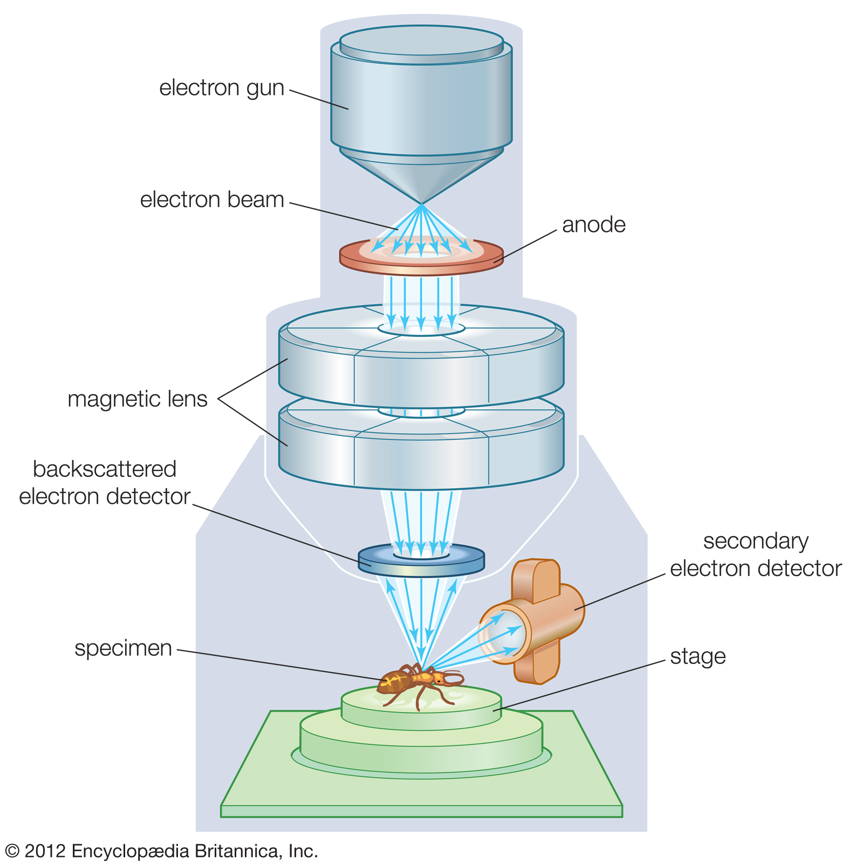
Scanning Electron Microscope
A scanning electron microscope (SEM) scans a focused electron beam over a surface to create an image.
Everhart-Thornley Detector

Slide 17
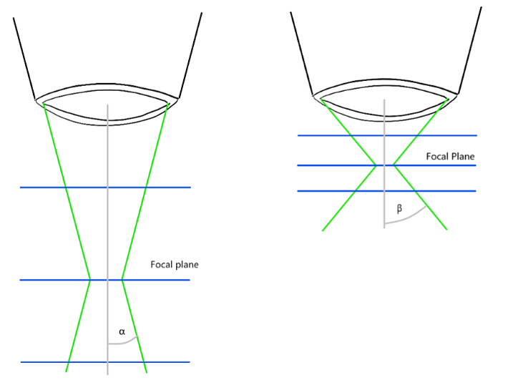
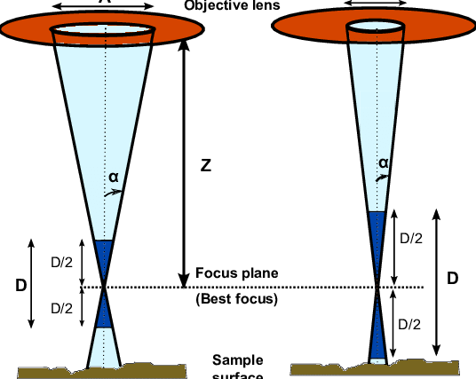
SEM Features
Effect of working distance
RESOLUTION: Improves when the beam waist size decreases.
- Improves by decreasing the working distance.
- Improves by decreasing final aperture size.
Improves by increasing acceleration voltage.
DEPTH OF FOCUS: The region where the beam size remains small, giving good resolution. A large depth of focus is more suitable for samples with large height or large step size.
- Increases by increasing the working distance.
Increases by decreasing the final aperture size.
Effect of final aperture size

Slide 18
Results and Conclusion

Slide 19
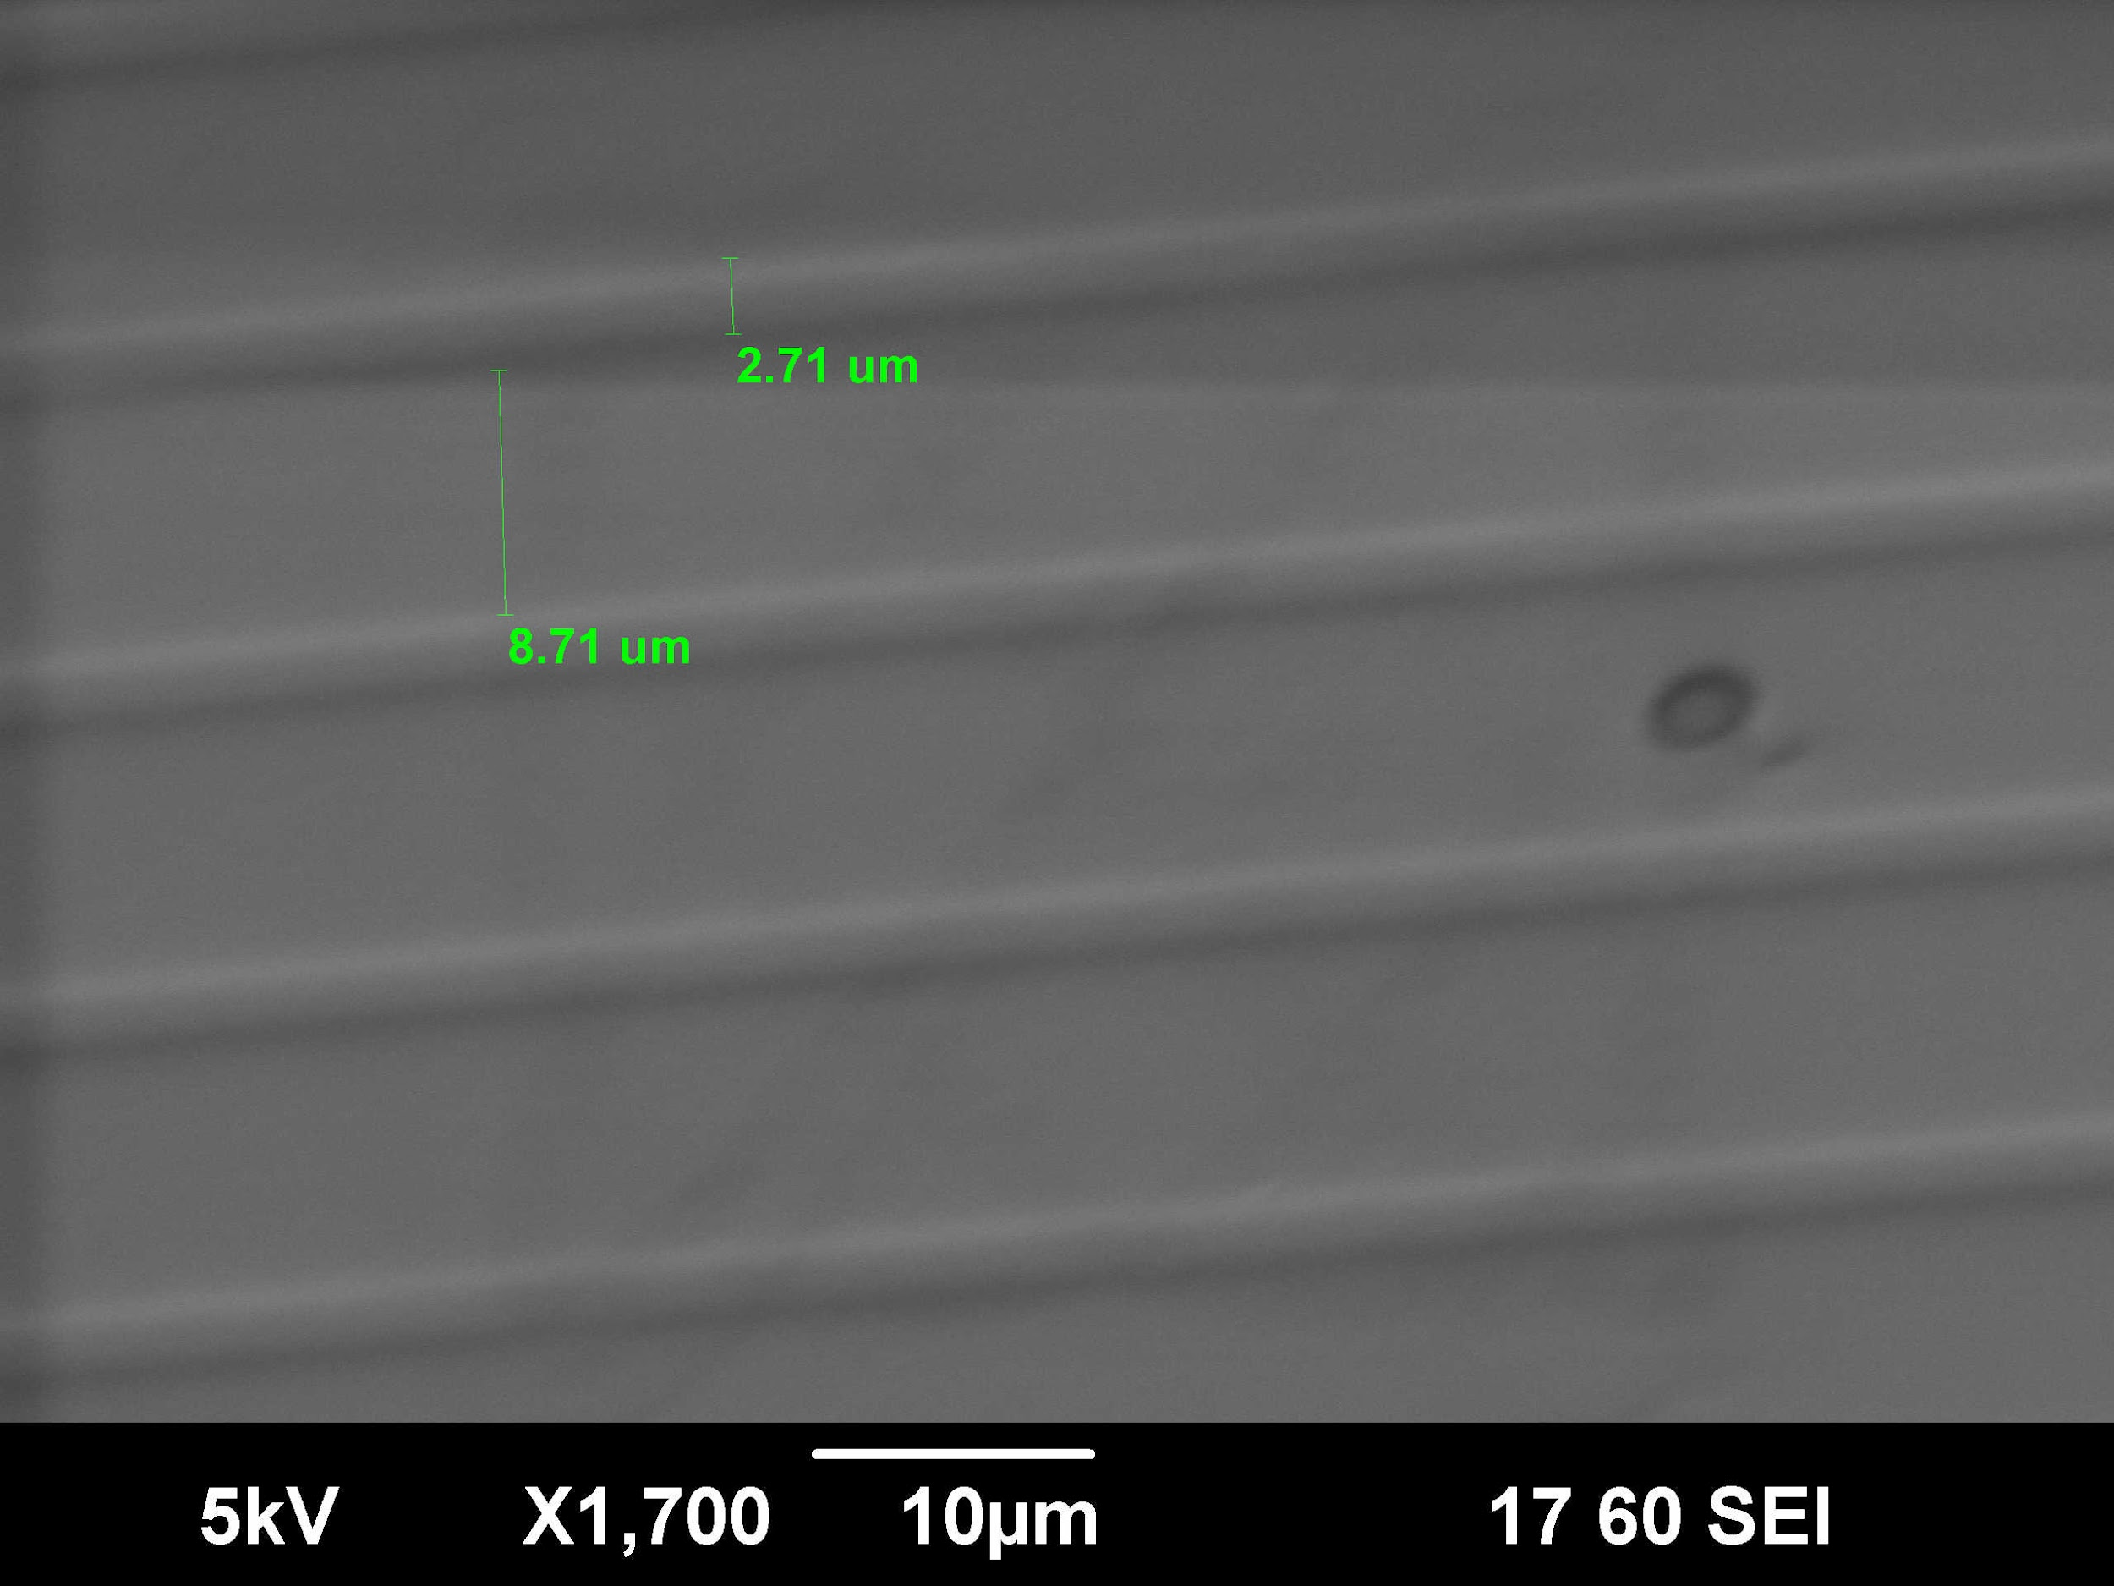
Results
Original Master (by light microscope)
Replicated NIL sample (by SEM)
11.87 um
11.42 um
Percentage error: 3.8%

Slide 20
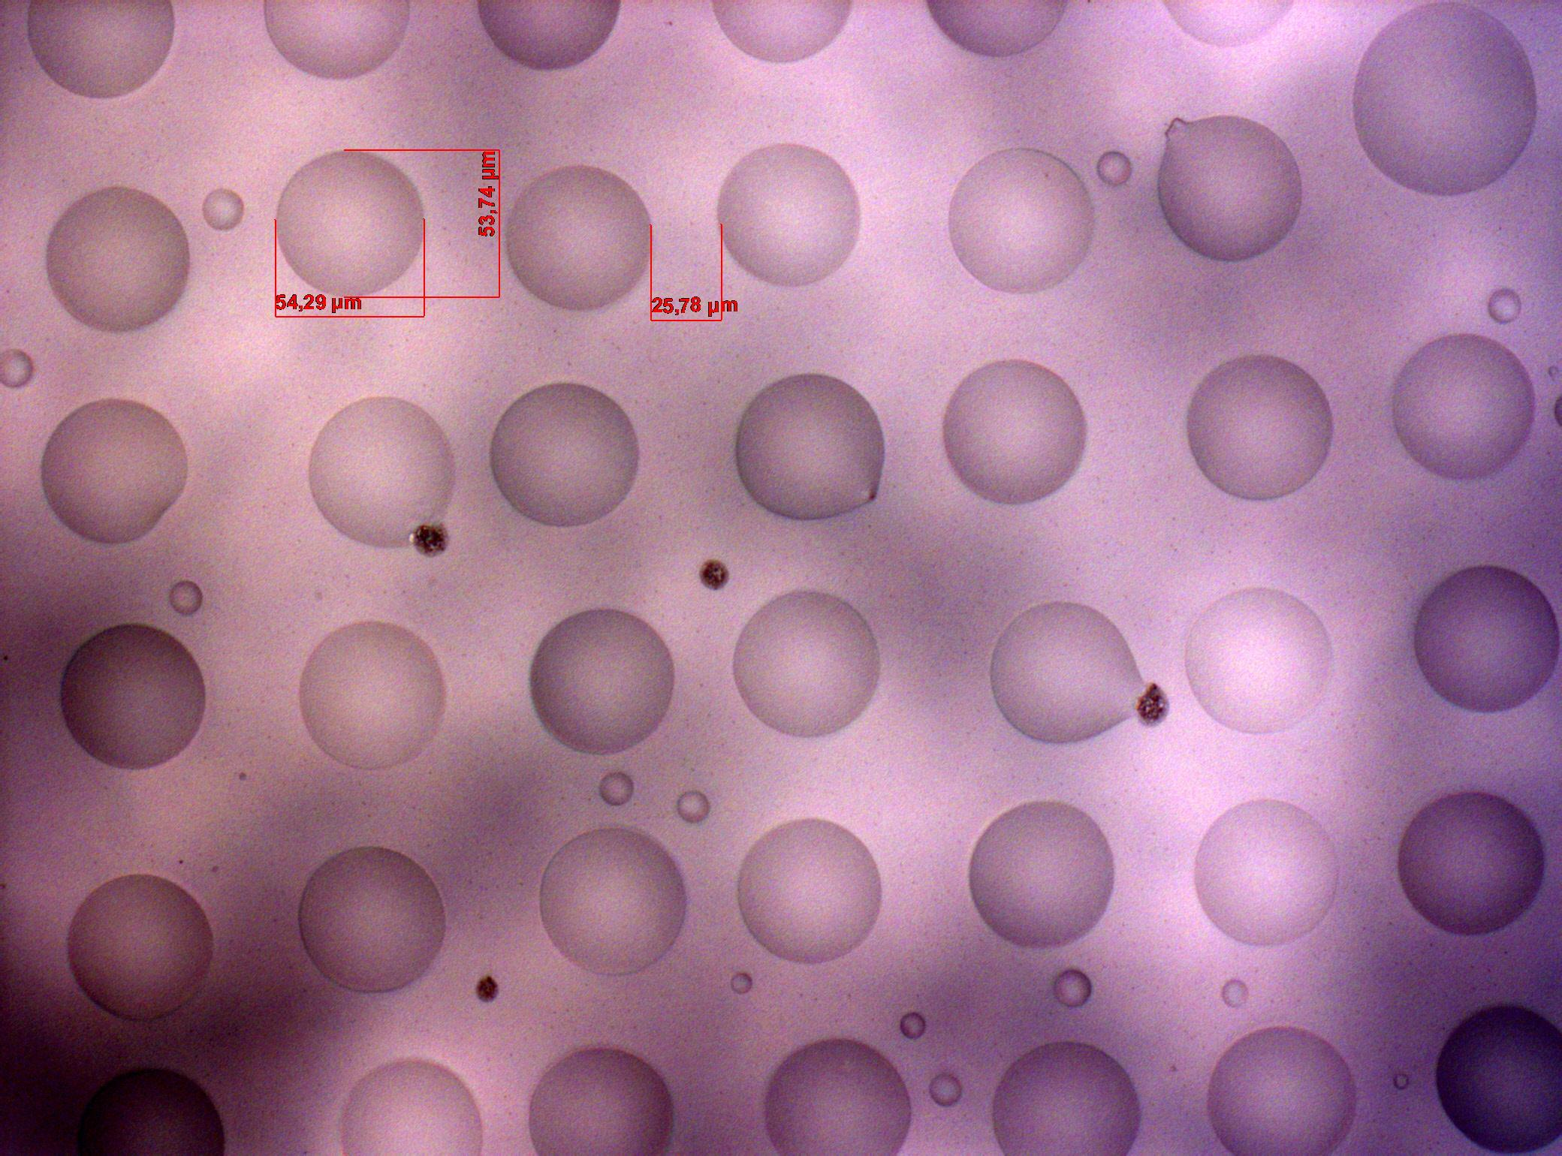
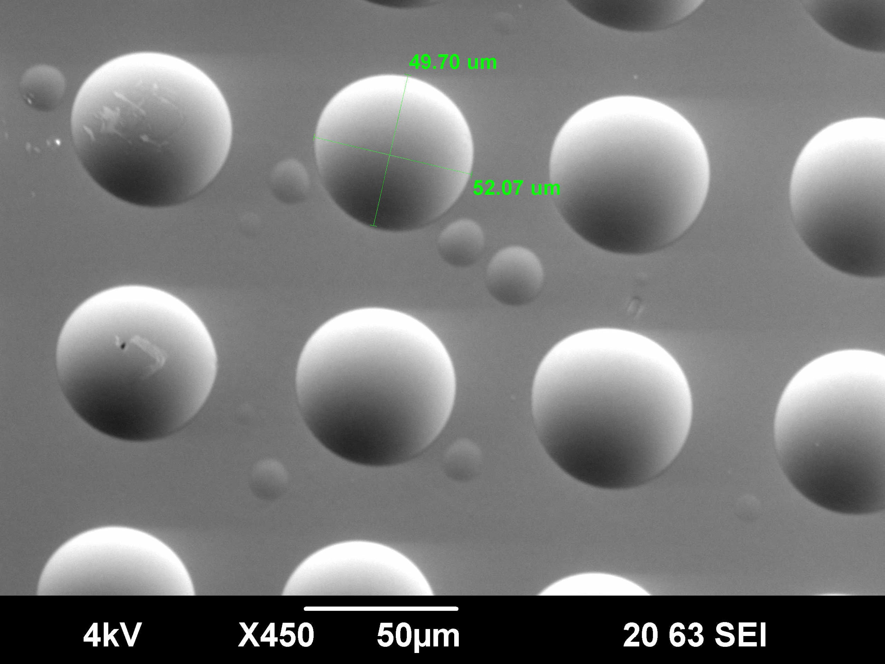
Results
Original Master (by light microscope)
Replicated NIL sample (by SEM)
Avg. Diameter: 54 um
Avg. Diameter: 50.9 um
Percentage error: 5.7%

Slide 21
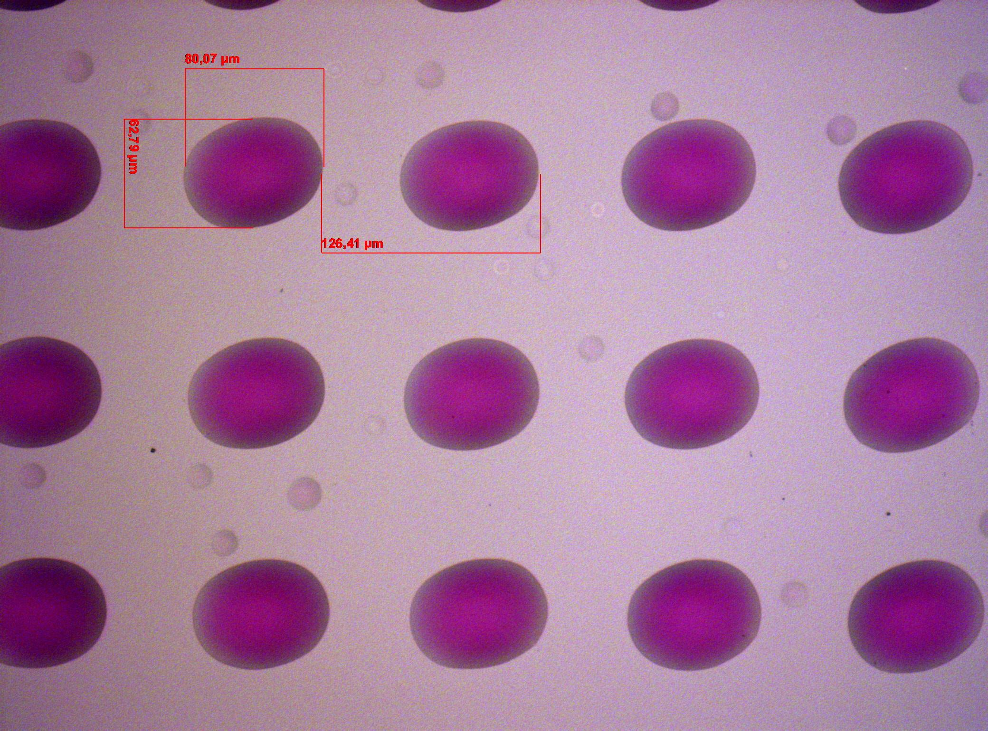
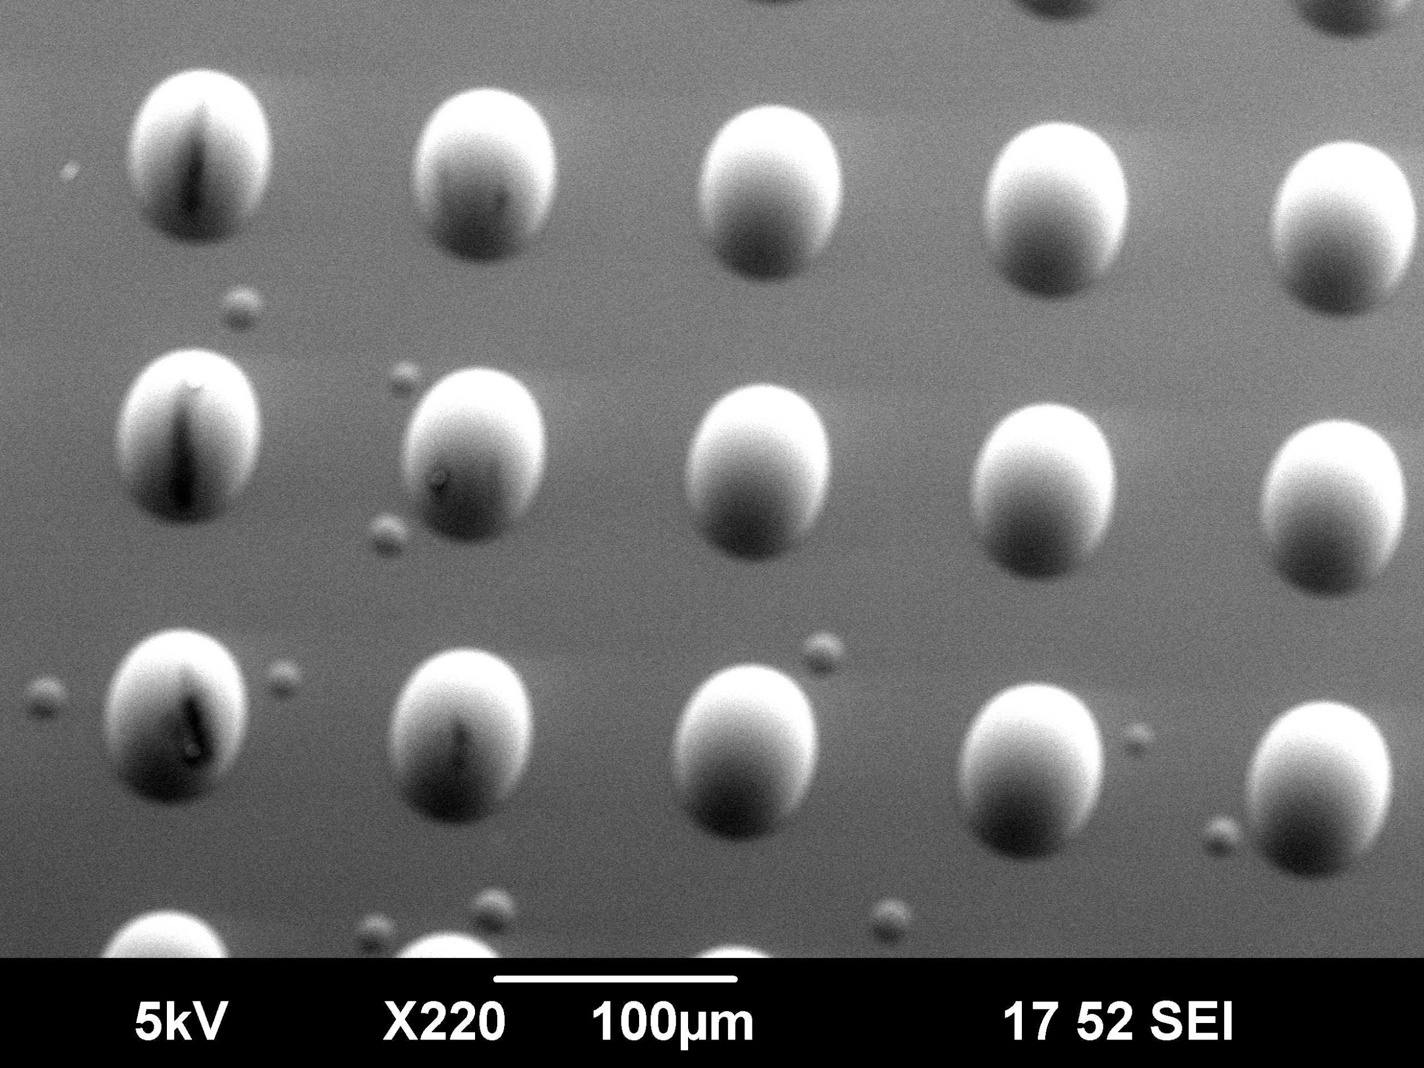
Results
Original Master (by light microscope)
Replicated NIL sample (by SEM)
Diameter: 79.1 um
Diameter: 80.1 um
Percentage error: 1.2%

Slide 22
Conclusion
In this lab, micro-sized features were achieved by NIL lithography, with an error of 3.8%, 5.7% and 1.2%.
Nanoimprint lithography is a simple and low-cost method of nano-fabrication, which eliminates many of the complexities in optical UV lithography.
By using a soft stamp (PDMS), applying it to the UV curable polymer (Ormostamp) and exposing it to UV radiation, it is possible to achieve good resolution and small feature sizes.
Care is needed in handling the slides and stamps to avoid sample damage.

Slide 23
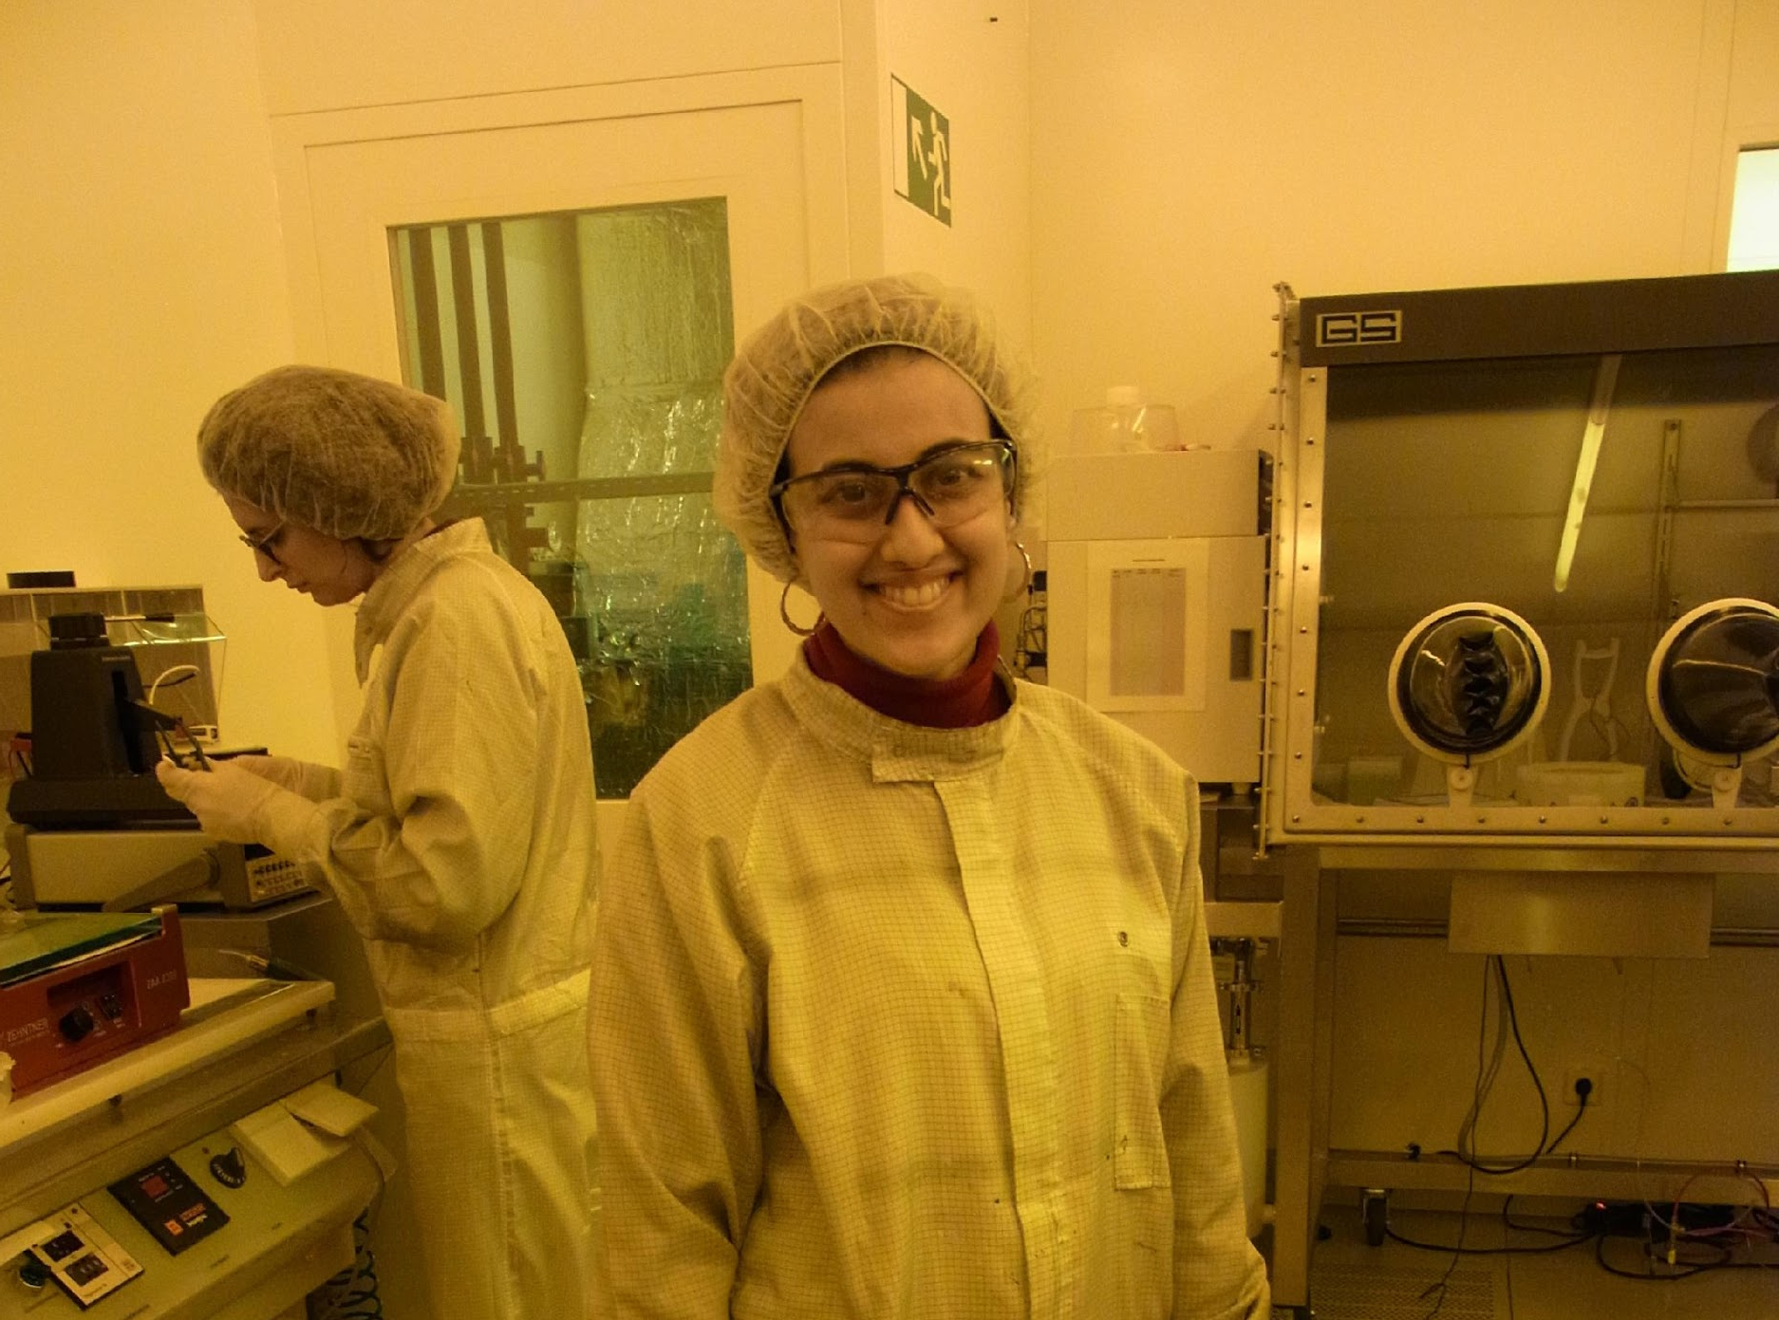
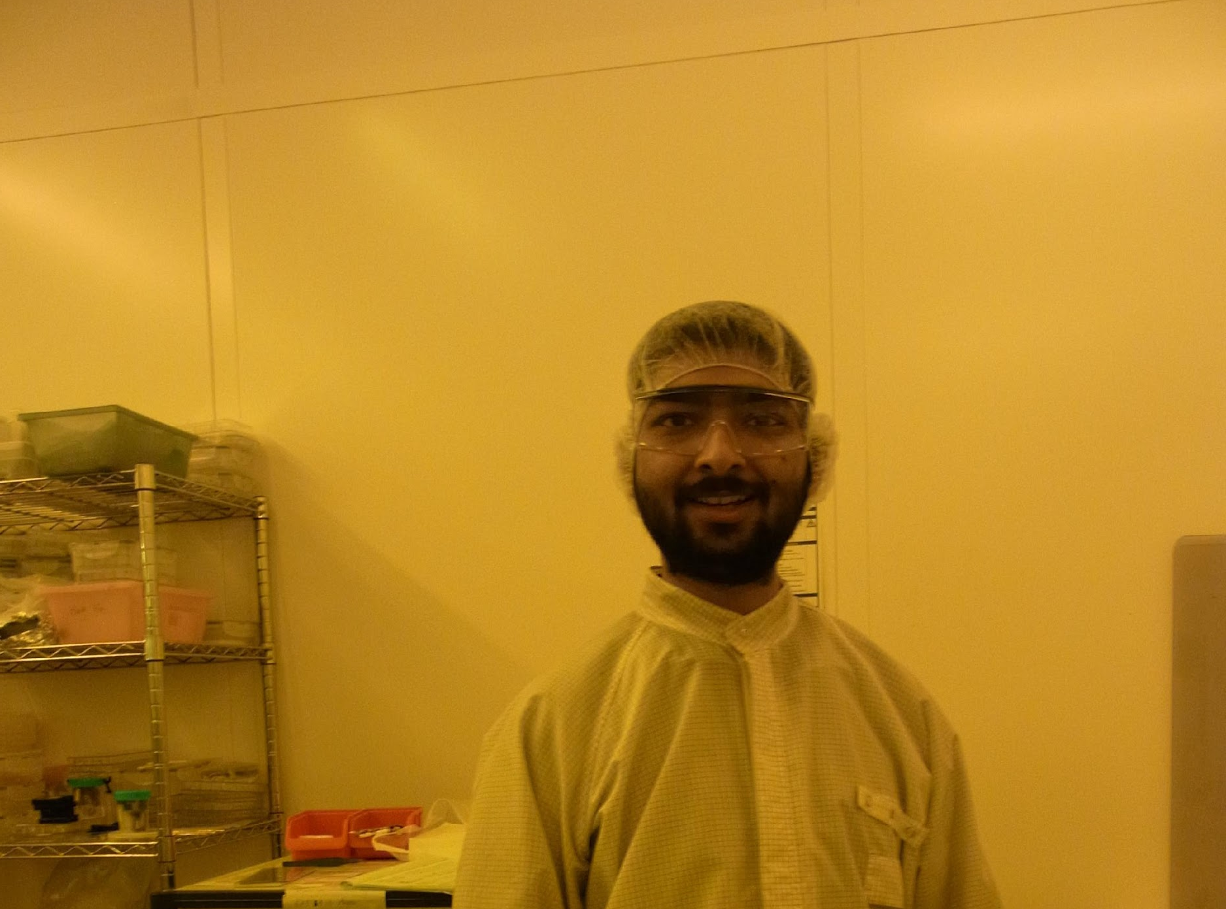
Thank You!

