Slide 1
Full Waveform Inversion
Lecture 3 in WS 2020/21
Shallow-seismic full-waveform inversion
Yudi Pan and Thomas Bohlen
Geophysical Institute, Karlsruhe Institute of Technology (KIT), Germany

Slide 2
Outline
Shallow seismic
Conventional shallow-seismic methods
FWI of shallow-seismic data
Challenges in shallow-seismic FWI

Slide 3
What is shallow seismic ?
The seismic method has three categories of applications with different depth:
(1) Shallow seismic (Engineering seismology)
a depth of interest down to 1 km
(2) Exploration seismic/seismology
a depth of interest down to 10 km
(3) Earthquake seismology
a depth of interest down to 100 km or more
Depth(m)
~10⁻¹
~10³
~10⁴
Shallow seismic
Exploration seismic
Earthquake seismology
The difference is more than a matter of scale!

Slide 4
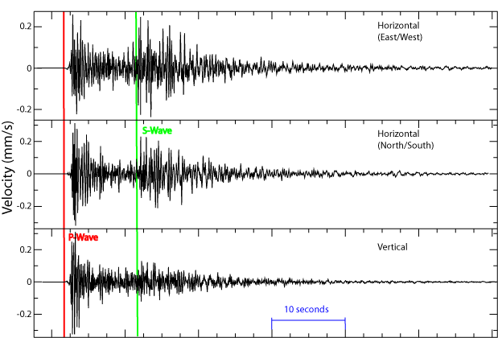
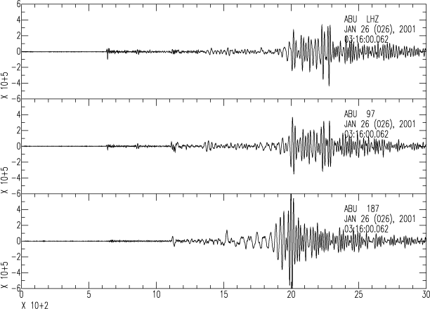
  Earthquake seismology

Slide 5
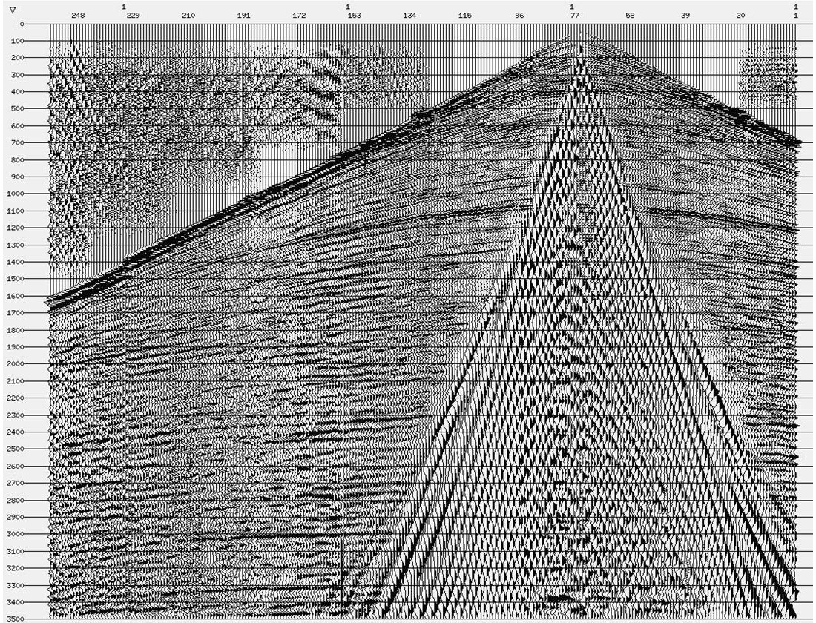
Exploration seismic
3.5 seconds

Slide 6
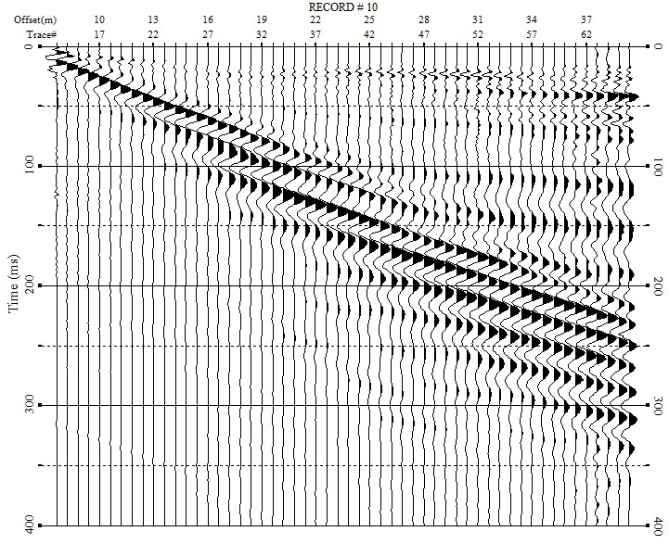
  Shallow seismic
0.4 second

Slide 7
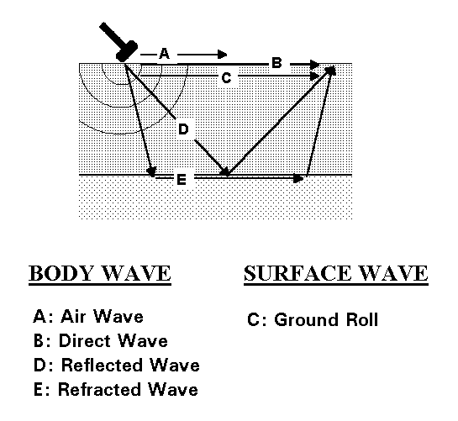
Shallow seismic wavefields
Surface waves dominate shallow-seismic wavefield
Wavetypes:
Rayleigh waves
Inline and vertical components
Love waves
crossline component

Slide 8
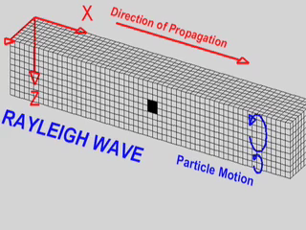
Shallow seismic wavefields
Rayleigh waves
Its particle motion is elliptical, retrograde, and prograde.
Coupled by P and SV waves.
(source: IRIS)

Slide 9
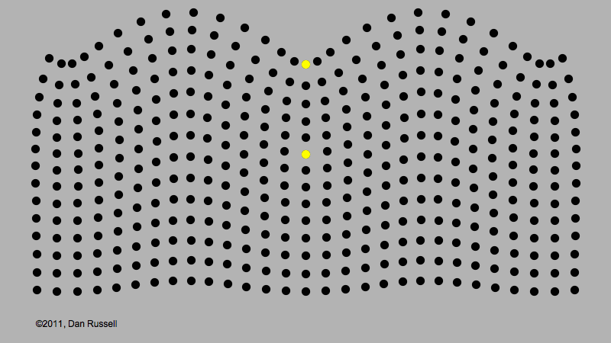
Shallow seismic wavefields
Particle motion of Rayleigh waves
elliptical, retrograde,
or prograde

Slide 10
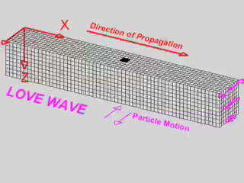
Shallow seismic wavefields
Love waves
Result from the interaction of SH waves.
Require a velocity structure that varies with depth, i.e., cannot exist in a homogeneous half-space.
Require that Vs₂ > Vs₁.
(source: IRIS)

Slide 11
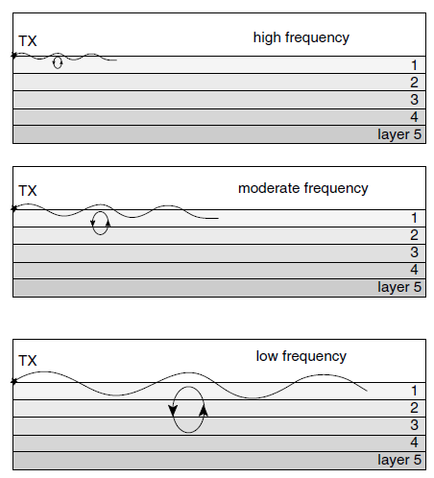
Shallow seismic wavefields
Characteristics of surface and body waves
Records of a seismic event begin with P waves, followed by S waves, and finally by surface waves.
Surface waves usually have larger amplitudes and lower frequency (longer periods)
Surface waves have the characteristics of dispersion (velocity depends on frequency).
Body waves propagate in a spherical way, while surface waves propagate in a cylindrical way.

Slide 12
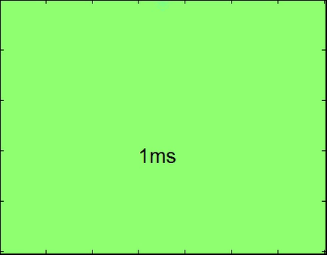
Rayleigh wave in a homogeneous half-space model
Vs = 577 m/s,
Vp = 1000 m/s,
den= 2.0 g/cm³
(Time)

Slide 13
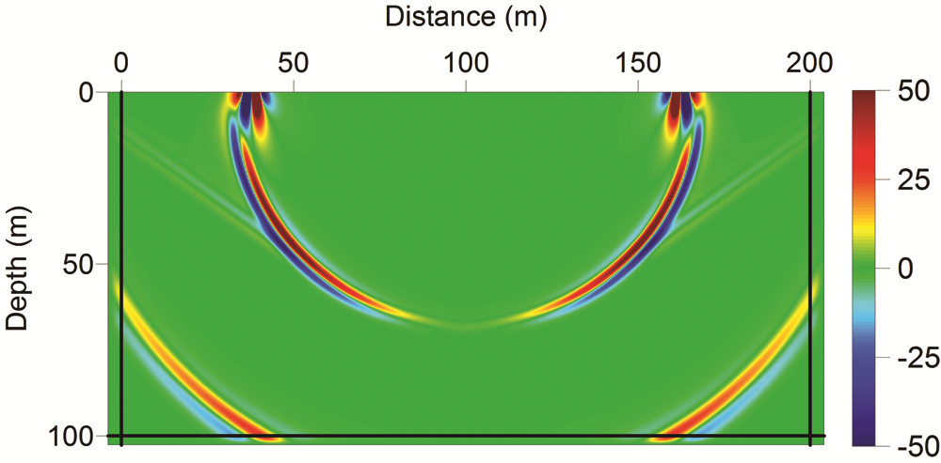
Rayleigh wave in a homogeneous half-space model
Only exist when
Poisson’s ratio > 0.26
Only exist when
Poisson’s ratio > 0.26
Surface
wave
Surface
wave
Leaky
Surface
wave
Leaky
Surface
wave
S wave
S wave
P wave
P wave
In a homogeneous half-space, Rayleigh wave velocity is about 0.92Vs if Poisson’s ratio = 0.25.
(Zeng et al., 2012)

Slide 14

Rayleigh wave in a layered model
Vs = 200 m/s, Vp = 600 m/s, den= 2.0 g/cm³
Vs = 500 m/s, Vp = 1000 m/s, den= 2.0 g/cm³
(Time)

Slide 15
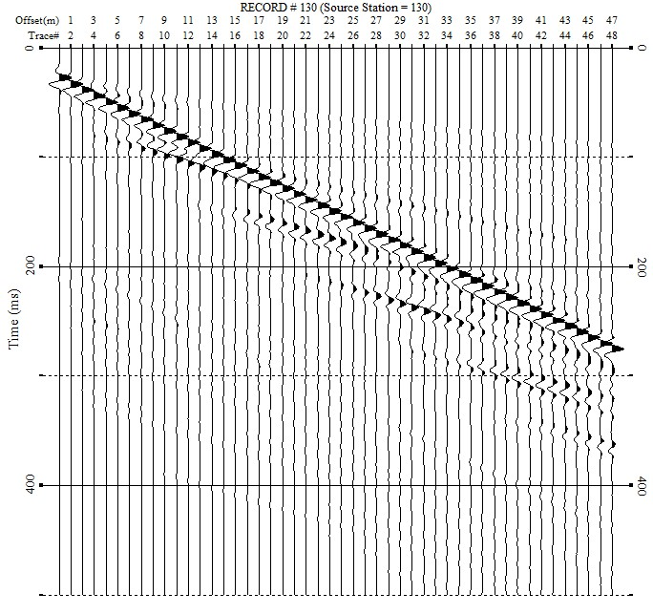
Rayleigh wave in a layered model
Layer 1:
Vs = 200 m/s,
Vp = 600 m/s,
h= 5 m,
den= 2.0 g/cm³
Dispersion image
Layer 2:
Vs = 500 m/s,
Vp = 1000 m/s,
den= 2.0 g/cm³

Slide 16
Shallow seismic wavefields
Travel time of the various waves
Distance
Direct P wave
Time

Slide 17
Shallow seismic wavefields
Travel time of the various waves
Distance
Refracted P wave
Direct P wave
Time

Slide 18
Shallow seismic wavefields
Travel time of the various waves
Distance
Refracted P wave
Reflected P wave
Direct P wave
Time

Slide 19
Shallow seismic wavefields
Travel time of the various waves
Distance
Refracted P wave
Reflected P wave
Direct P wave
Rayleigh waves
Time

Slide 20
Shallow seismic wavefields
Travel time of the various waves
Distance
Refracted P wave
Reflected P wave
Direct P wave
Air wave
Rayleigh waves
Time

Slide 21
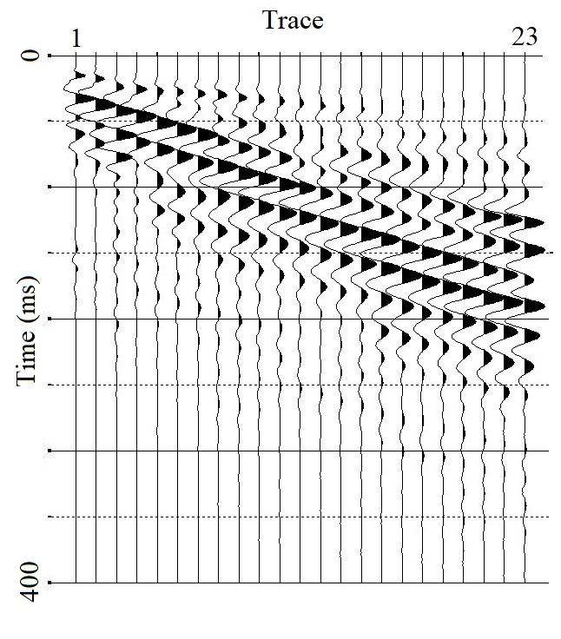
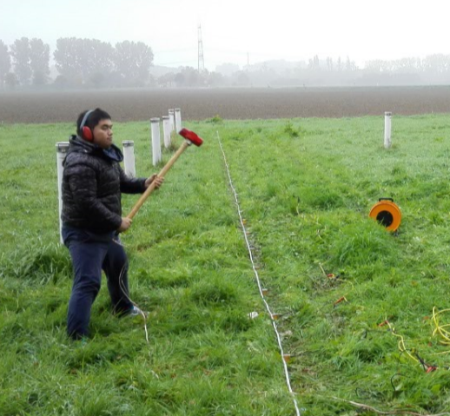
Shallow seismic wavefields
Direct wave
Location: FZJ, Germany
Nearest offset: 2 m
Trace interval: 1 m
Vertical source (hammer)
Vertical geophones
Refracted wave
Surface wave

Slide 22
Outline
Shallow seismic
Conventional shallow-seismic methods
FWI of shallow-seismic data
Challenges in shallow-seismic FWI

Slide 23
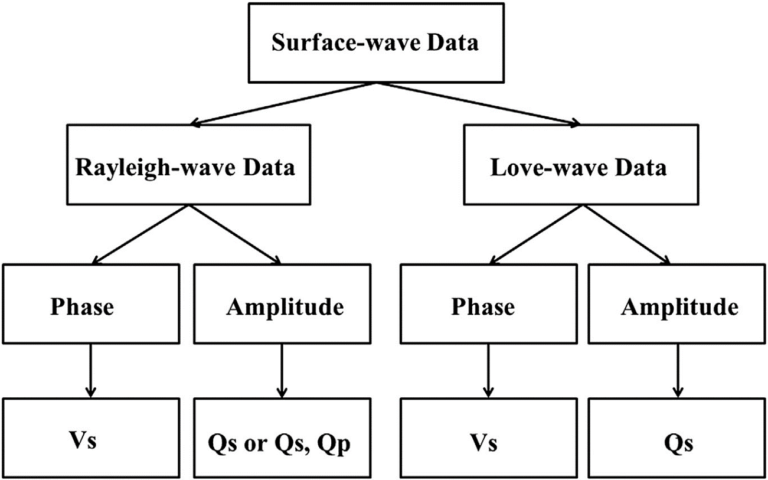
Shallow-seismic Data
Body-wave Data
Refracted-wave
data
Reflected-wave
data
acoustic impedance
Vp or Vs

Slide 24
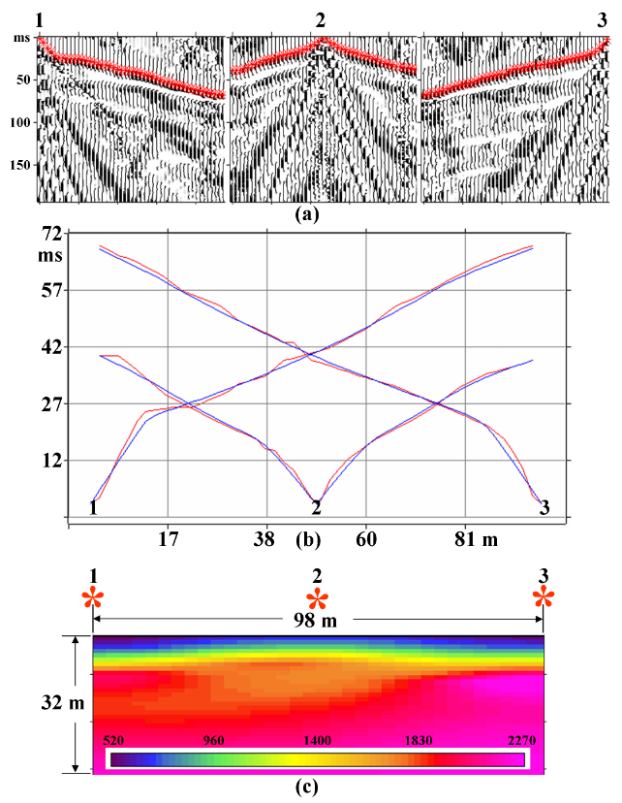
Refraction seismic
Primary processes for refracted waves
Picking first arrivals
Travel-time tomography
(Engineering Seismology …, Yilmaz)

Slide 25
Refraction seismic
Problems in refraction seismic
Hidden layers in first arrivals
Case 1: low-velocity layer
Distance
Direct wave
source
Arrivals from layer 3
v1
v2
(v2 < v1)
Time
v3

Slide 26
Refraction seismic
Problems in refraction seismic
Hidden layers in first arrivals
Case 2: thin layer with strong contrast
Distance
Direct wave
source
Arrivals from layer 3
v1
Arrivals from layer 2
v2
v3
Time

Slide 27
Refraction seismic
Problems in refraction seismic
Hidden layers in first arrivals
Case 3: missing of arrivals with sparse spread
Distance
Direct wave
source
Arrivals from layer 3
v1
Arrivals from layer 2
v2
v3
Time

Slide 28

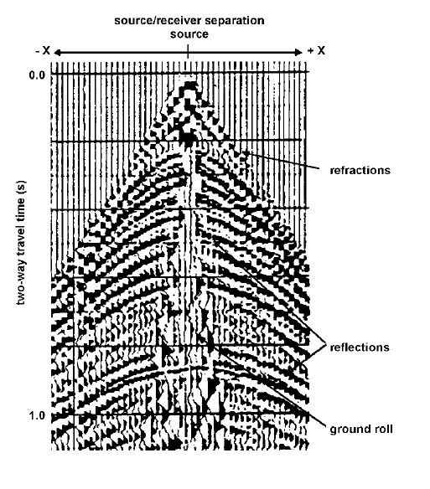
Reflection seismic
Problems in reflection seismic
Due to the high heterogeneity of near-surface materials and high noise level in urban environment, it is always challenging in acquiring reflected waves of good quality.
Correct recognizing of seismic reflection is not easy.
This technique more expensive in terms of time and money comparing to other techniques.

Slide 29
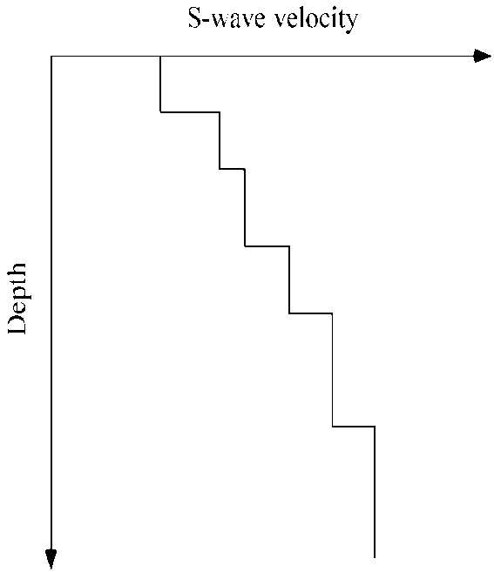
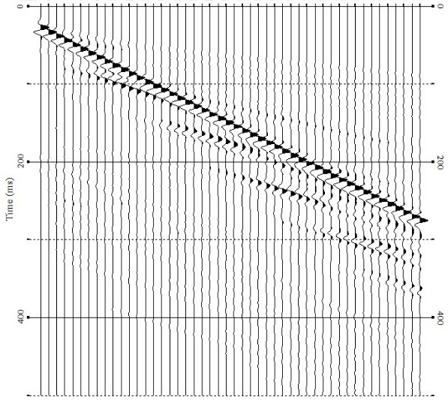
Surface-wave method
Multichannel Analysis of Surface Wave (MASW)
1. Imaging dispersion curve
2. Inverting dispersion curve
Field data Dispersion curve S-wave velocity profile

Slide 30

Limitations
Surface-wave method
1D model approximation
Accurate picking of dispersion curve
Nonlinearity in the inversion

Slide 31
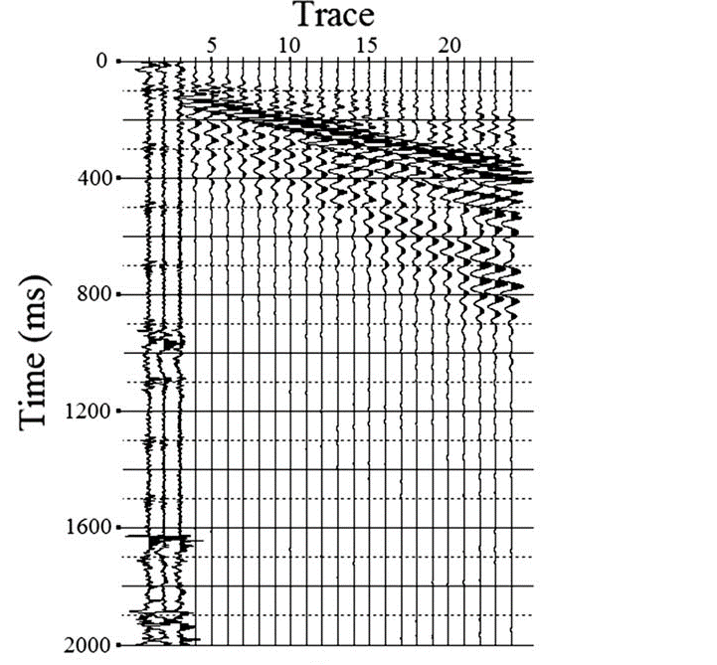
Limitations of surface-wave method
Accurate picking of dispersion curve
Boise Hydrogeophysical Research Site (BHRS)
Corresponding dispersion image
The raw field data of Rayleigh wave

Slide 32
Limitations of surface-wave method
(Gao et al., 2016)

Slide 33
Outline
Shallow seismic
Conventional shallow-seismic methods
FWI of shallow-seismic data
Challenges in shallow-seismic FWI

Slide 34
Conventional shallow-seismic methods
Most of the shallow-seismic methods only exploit a (small) portion of information in seismic data
MASW -> averaged phase difference of surface waves
Refraction -> kinematic information of first arrival
data
model
Only exploits part of the information content of seismic signals

Slide 35

Conventional shallow-seismic methods
A case study in Kansas, USA
Surface wave + refraction

Slide 36
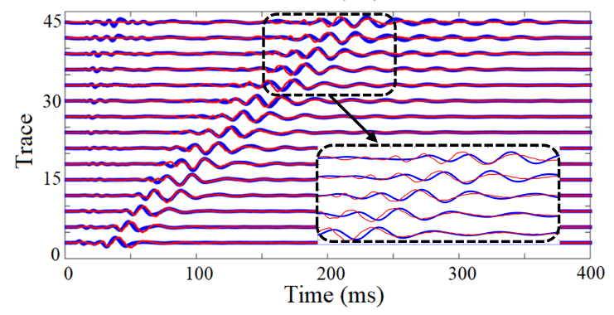
Conventional shallow-seismic methods
A case study in Kansas, USA
Could we further squeeze the data?

Slide 37
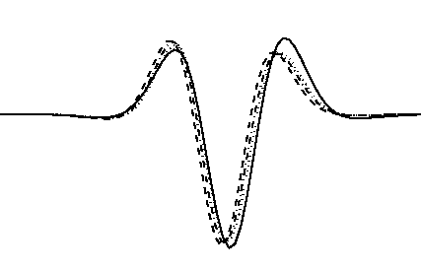
Full waveform inversion (FWI)
FWI exploits the full information content of seismic signals
Use all wave types, both kinematic and dynamic information
Heterogeneous model
High resolution
High comp. cost & nonlinearity
Questions for shallow-seismic FWI
How to apply ?
Can we infer lateral variations of Vs ?
Can we derive multi-parameter models?
model
data

Slide 38
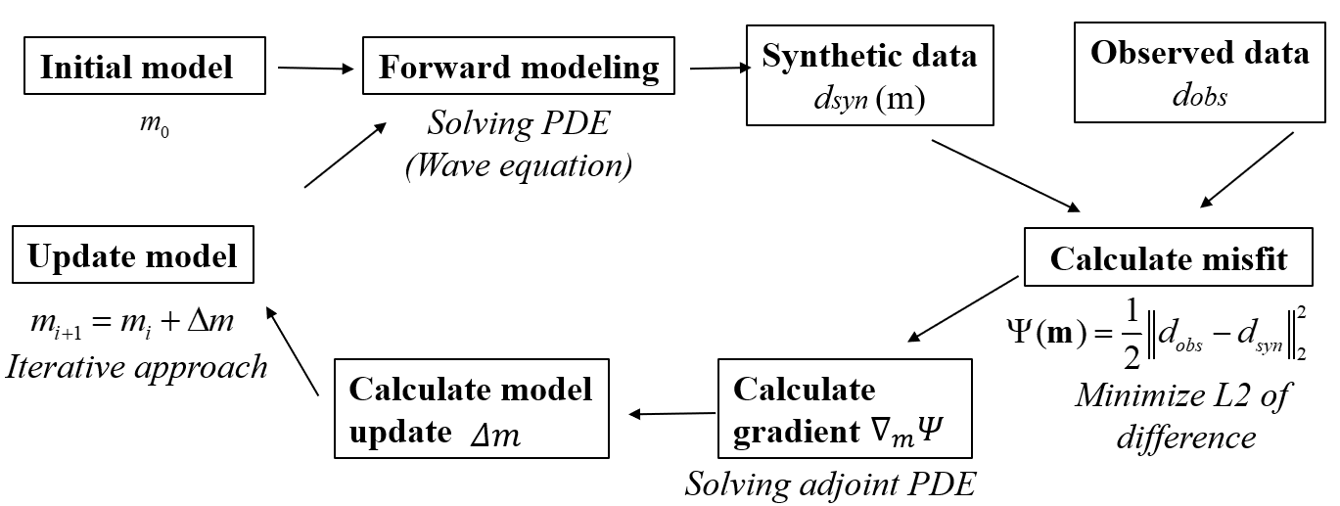
Full waveform inversion (FWI)
Minimal tasks
wave modelling
gradient calculation
model update

Slide 39
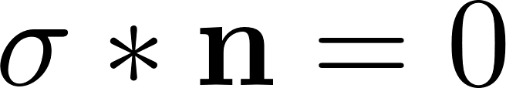
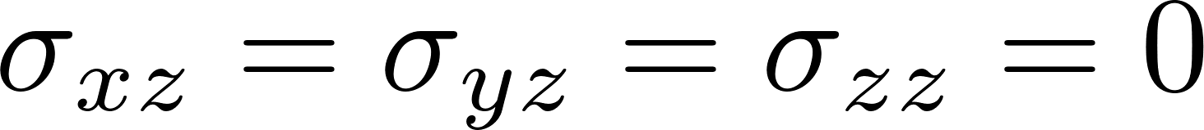

Forward modeling
2D P-SV elastic-wave equation
2D SH elastic-wave equation
Free-surface condition
for flat free surface:
where v represents the particle velocity, b represents buoyancy (reciprocal of density ρ), μ and λ represent the Lamé coefficients, τ represents the shear stresses

Slide 40
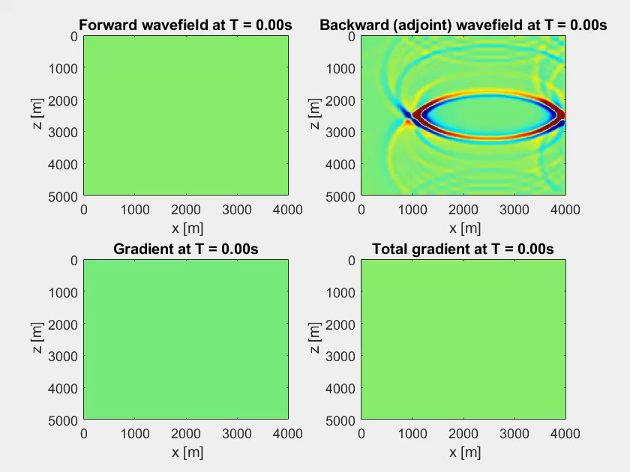
Gradient calculation: adjoint state method
Forward simulation
Adjoint simulation
Cross-correlation

Slide 41
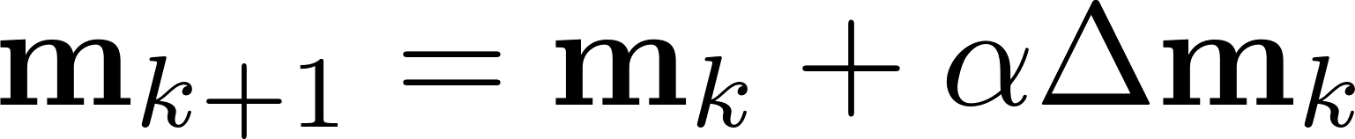
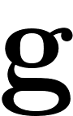
Model update
Iteratively update the model (line search)
Optimization algorithm: Preconditioned CG
  Other options:
  (Preconditioned) Steepest descent method
  (Preconditioned) L-BFGS method
  (Preconditioned) Gauss-Newton method
  (Preconditioned) Truncated Newton method

Slide 42

Resolution test
True model
5 sources (11 m interval)
40 traces (1 m interval)
1 m x 1 m blocks
Source time function: 40 Hz Ricker wavelet
Minimum wavelength ~ 2 m
Initial model: without checkerboard

Slide 43
Resolution test
FWI with/without topography:
Resolution ~ wavelength/2
(Pan et al., 2018)

Slide 44
Outline
Shallow seismic
Conventional shallow-seismic methods
FWI of shallow-seismic data
Challenges in shallow-seismic FWI

Slide 45
Challenges in shallow-seismic FWI
Nonlinearity
Attenuation

Slide 46
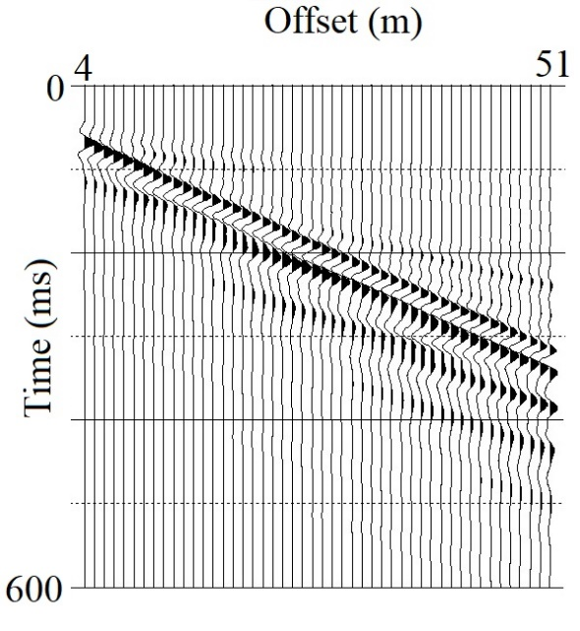

Nonlinearity of FWI
Conventional FWI
u^{syn} and u^{obs} are the synthetic and observed waveforms.
s_{r} and x_{r} represents the locations of sources and receivers.
T represents the total recording time

Slide 47
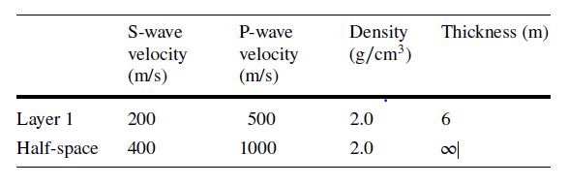
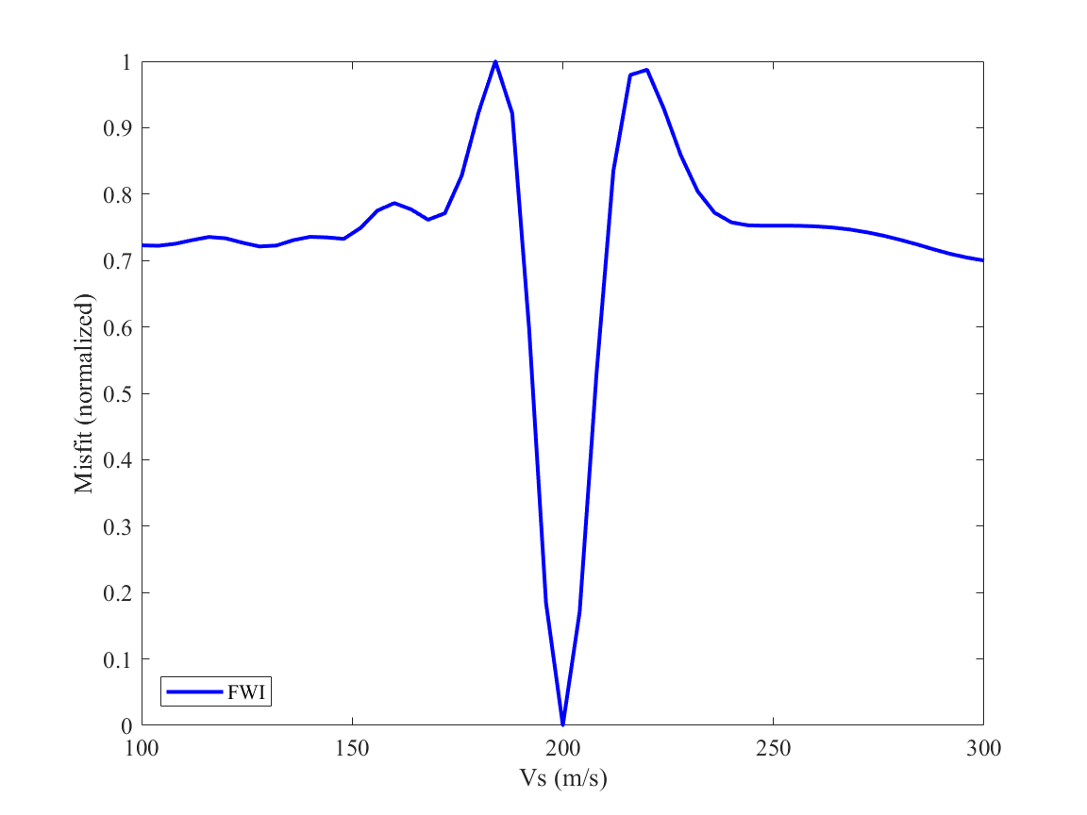
Nonlinearity of FWI
A single-parameter example
global minimum basin

Slide 48
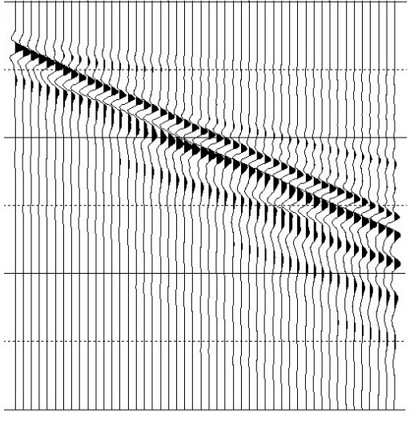
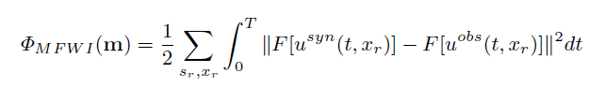
Reducing nonlinearity of FWI
Modified FWI objective functions:
Conventional FWI
Multiscale FWI
From long wavelength to short wavelength
(0 – 15 Hz)

Slide 49

Reducing nonlinearity of FWI
Modified FWI objective functions:
Conventional FWI
Alternative spectrum-based FWI (AFWI)
From x-t domain to f-k domain

Slide 50
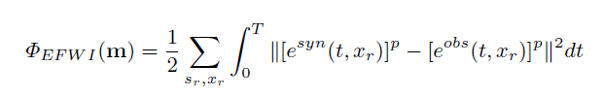
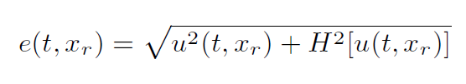
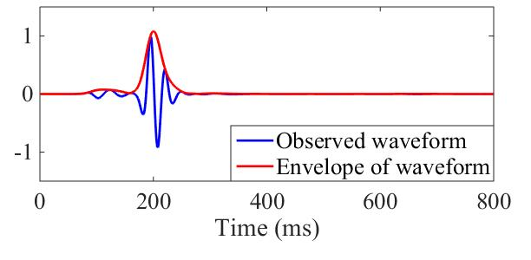
Reducing nonlinearity of FWI
Modified FWI objective functions:
Envelope-based FWI (EFWI)
where

Slide 51
Reducing nonlinearity of FWI
Modified FWI objective functions:
Conventional FWI
Envelope-based FWI (EFWI)
From single to group
From long to short wavelengths

Slide 52
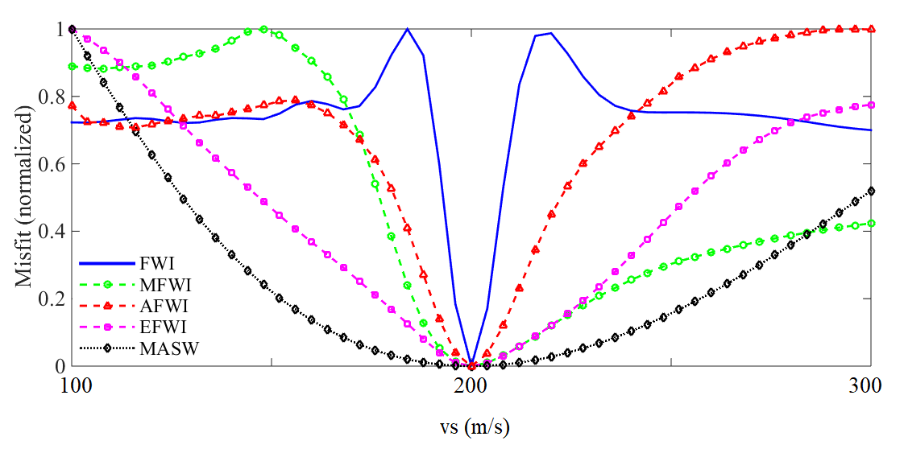
Nonlinearity of FWI
A single-parameter example

Slide 53
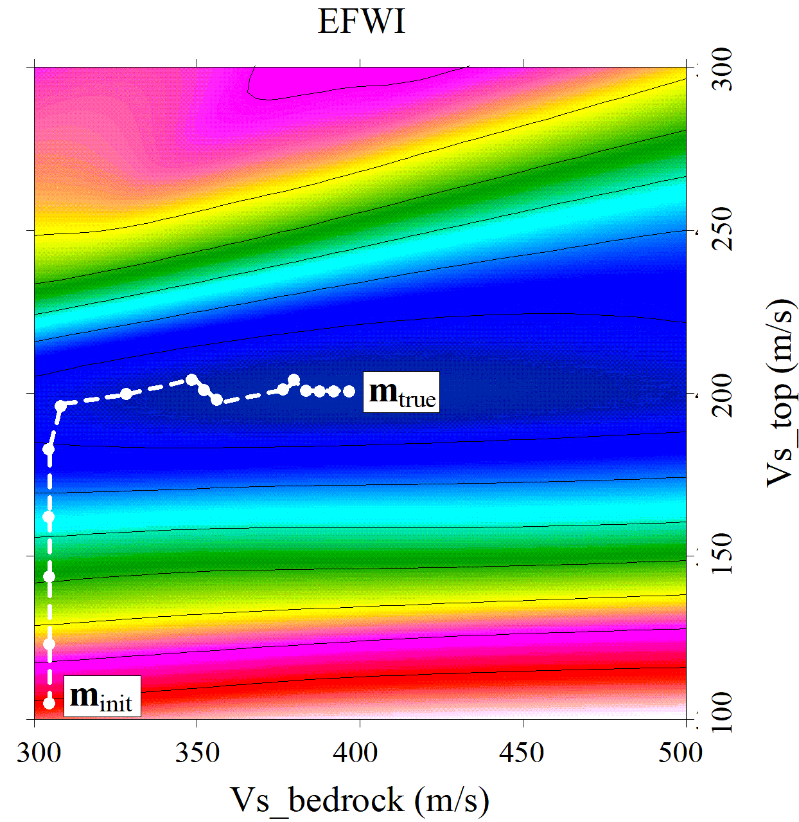
Nonlinearity of FWI
Two-parameter inversion example
Solution path of an initial model
Optimization algorithm: CG

Slide 54
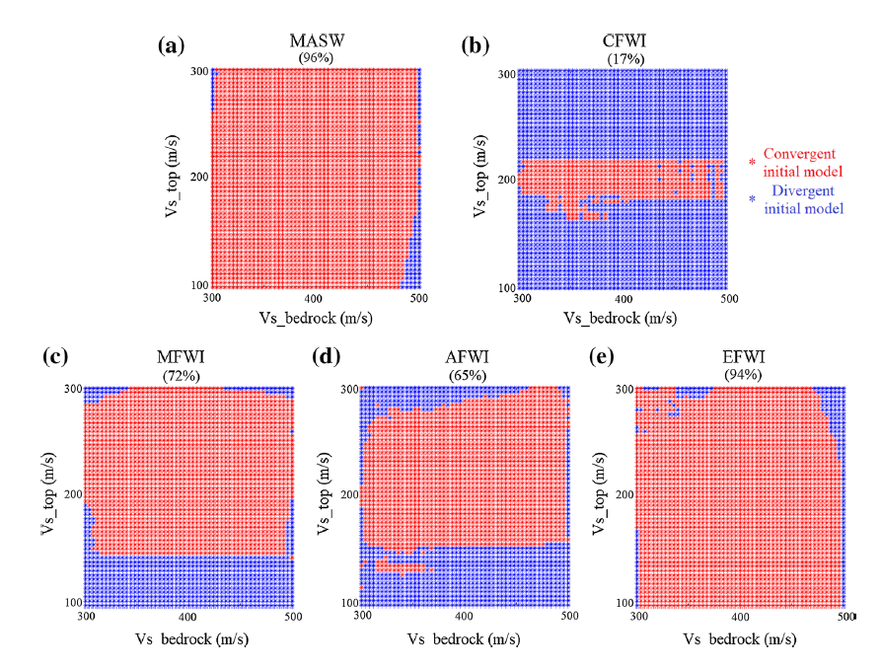
Reducing nonlinearity of FWI

Slide 55
A real-world case
Olathe, Kansas, USA
Vertical hammer source
vertical receivers (4.5 Hz)
Nearest offset: 3.6 m
Trace interval: 0.6 m
Source interval: 6 m

Slide 56
A real-world case
Multiscale FWI
Olathe, Kansas, USA
Vertical hammer source
vertical receivers (4.5 Hz)
Nearest offset: 3.6 m
Trace interval: 0.6 m
Source interval: 6 m

Slide 57
A real-world case
Inversion result
(Pan et al., 2019)

Slide 58
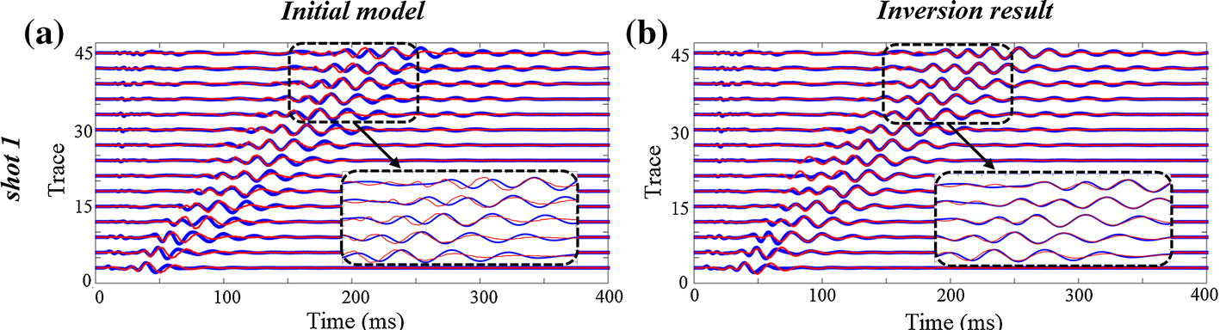
A real-world case
Waveform fitting

Slide 59
Short summary on nonlinearity
Hierarchical strategy
High
Modified FWI
FWI
Nonlinearity
Conventional
Methods
(MASW, refraction)
Low
High
Resolution

Slide 60
Challenges in shallow-seismic FWI
Nonlinearity
Attenuation

Slide 61
Attenuation
Conventional FWI
Mono (multi) -parameter acoustic/elastic FWI
Seismic attenuation
delineate the absorption of the wave energy
distort the phase of the wave.

Slide 62
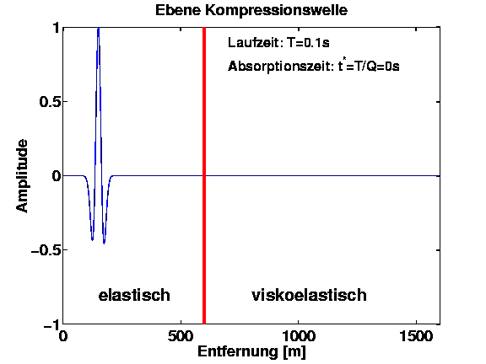
Attenuation
plane wave
Amplitude decays with distance
Loss of high-frequencies energy with distance
Dispersion
elastic
viscoelastic
Distance (m)

Slide 63
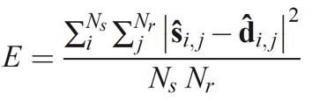
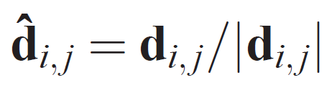
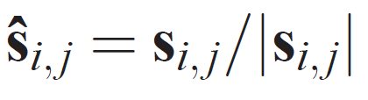
Attenuation in FWI
Mitigating the influence of attenuation
L2-Misfit of normalized seismograms
: normalized
observed seismograms
: normalized
synthetic seismograms

Slide 64
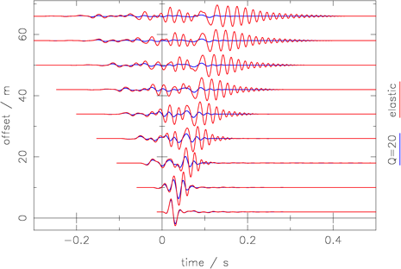
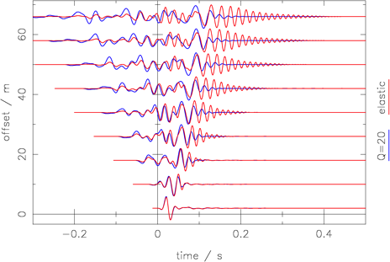
Attenuation in FWI
Amplitude decays with distance -> misfit definition
Loss of high-frequencies energy with distance
Dispersion
raw seismograms
normalized seismograms
Elastic data
Viscolastic data (Q=20)

Slide 65
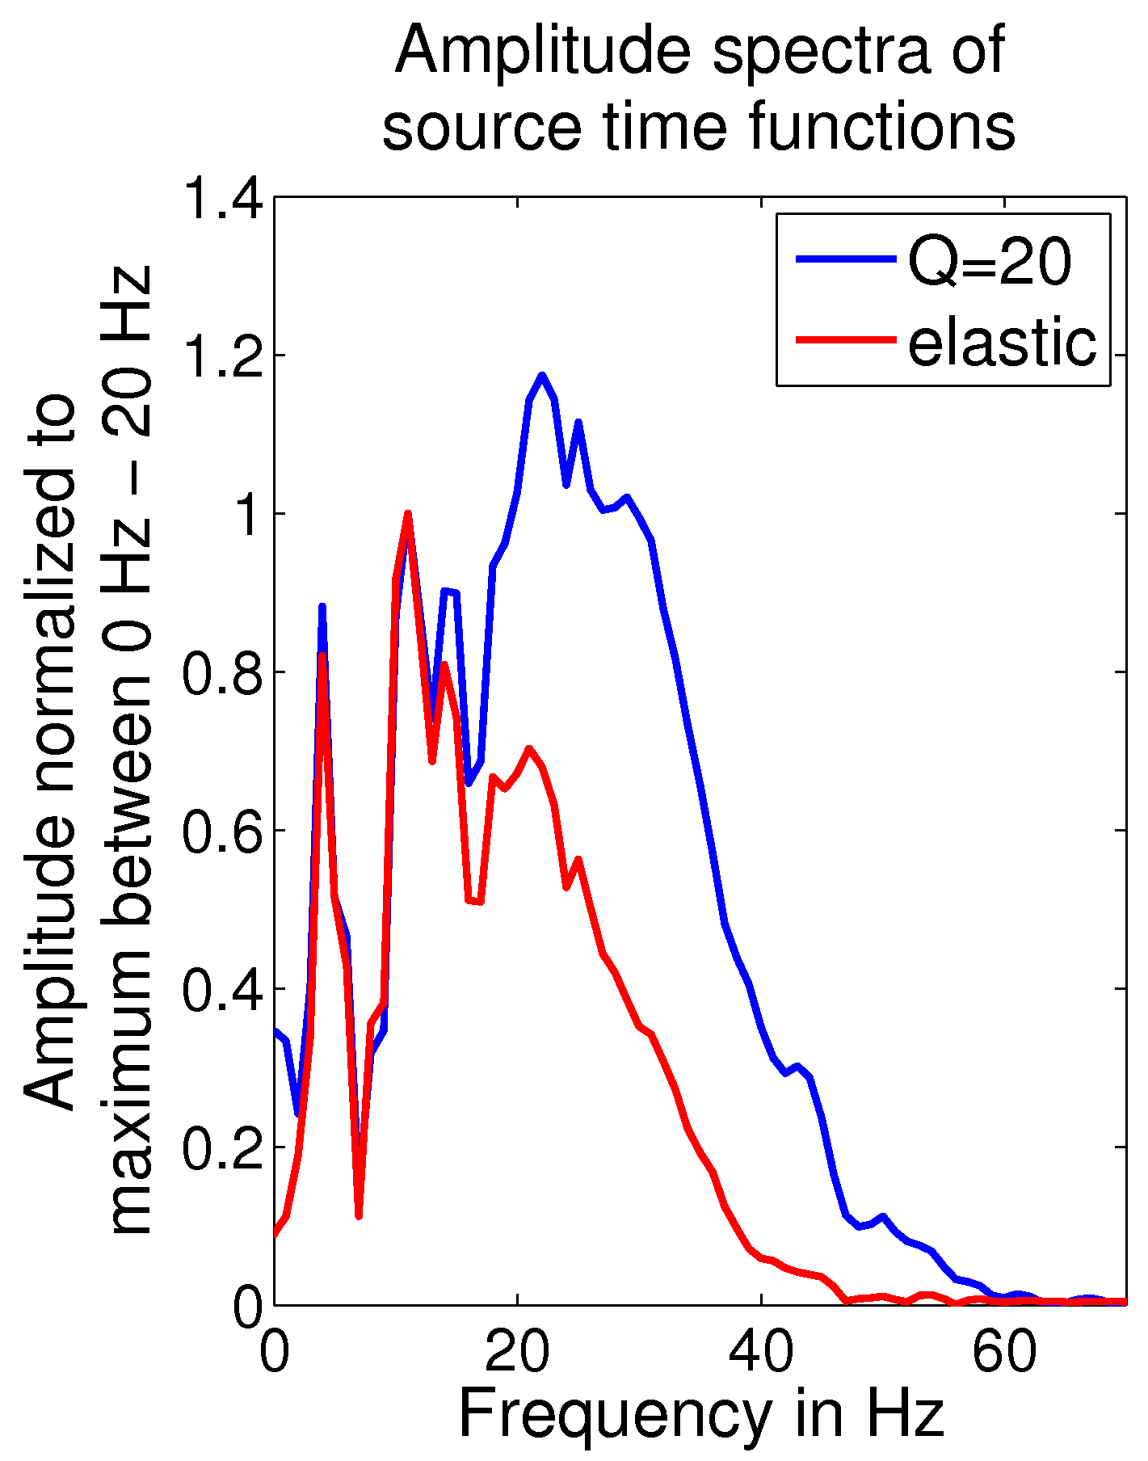
Attenuation in FWI
Amplitude decays with distance
Loss of high-frequencies energy with distance -> STF inversion
Dispersion
The STF inversion acts as a low-pass filter
(Groos et al., 2014)

Slide 66
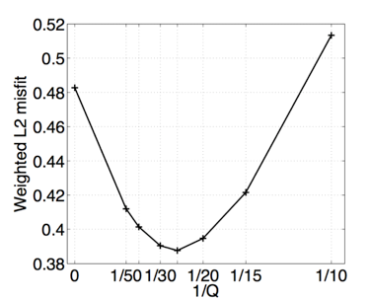
Attenuation in FWI
Amplitude decays with distance
Loss of high-frequencies energy with distance
Dispersion
Viscoelastic
forward modeling
A priori Q estimation

Slide 67
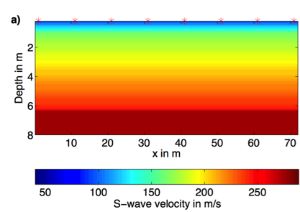
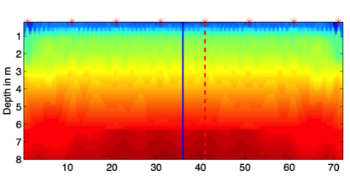
Synthetic reconstruction tests are successful
True model (Q=20)
During elastic FWI
Use L2-misfit of normailzed seismograms
Source wavelet inversion
Viscoelastic forward modeling
Inverted model (incorrect Q model)
(Groos et al., 2014)

Slide 68
Attenuation in FWI
Viscous effects:
affect amplitude (and phase)
link to rock type, fluid saturation, reservoir properties
Could we estimate Q models by FWI?

Slide 69
Viscoelastic FWI -- Adjoint state methods
Forward PDE (not self-adjoint)
Adjoint PDE
“Same” code
(Fabien-Ouellet et al., 2017)

Slide 70


Viscoelastic FWI
Elastic vs viscoelastic FWI
True model
Initial model

Slide 71
Viscoelastic FWI
Elastic vs viscoelastic FWI
Viscoelastic FWI
Elastic FWI

Slide 72
Viscoelastic FWI

Slide 73



Field-data test
Location: Rheinstetten, Karlsruhe, Germany

Slide 74


Field-data test
Vertical hammer source
Vertical receivers (4.5 Hz)
Trace interval: 1 m
Source interval: 4 m
Number of shots: 12

Slide 75
Field-data
test

Slide 76

Field-data test

Slide 77

Field-data test
Comparison with GPR profile

Slide 78
Short summary on attenuation
Influences of attenuaton can be mitigated in elastic FWI by using a normalized misfit function.
Artefact might be introduced when applying elastic FWI on viscoelastic model.
It is promising to use viscoelastic FWI to obtain multiparameter models.

Slide 79
Thank you!
THIS IS A SECTION SUBTITLE

